Slide 2
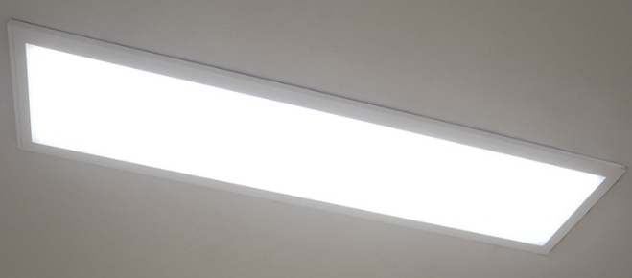
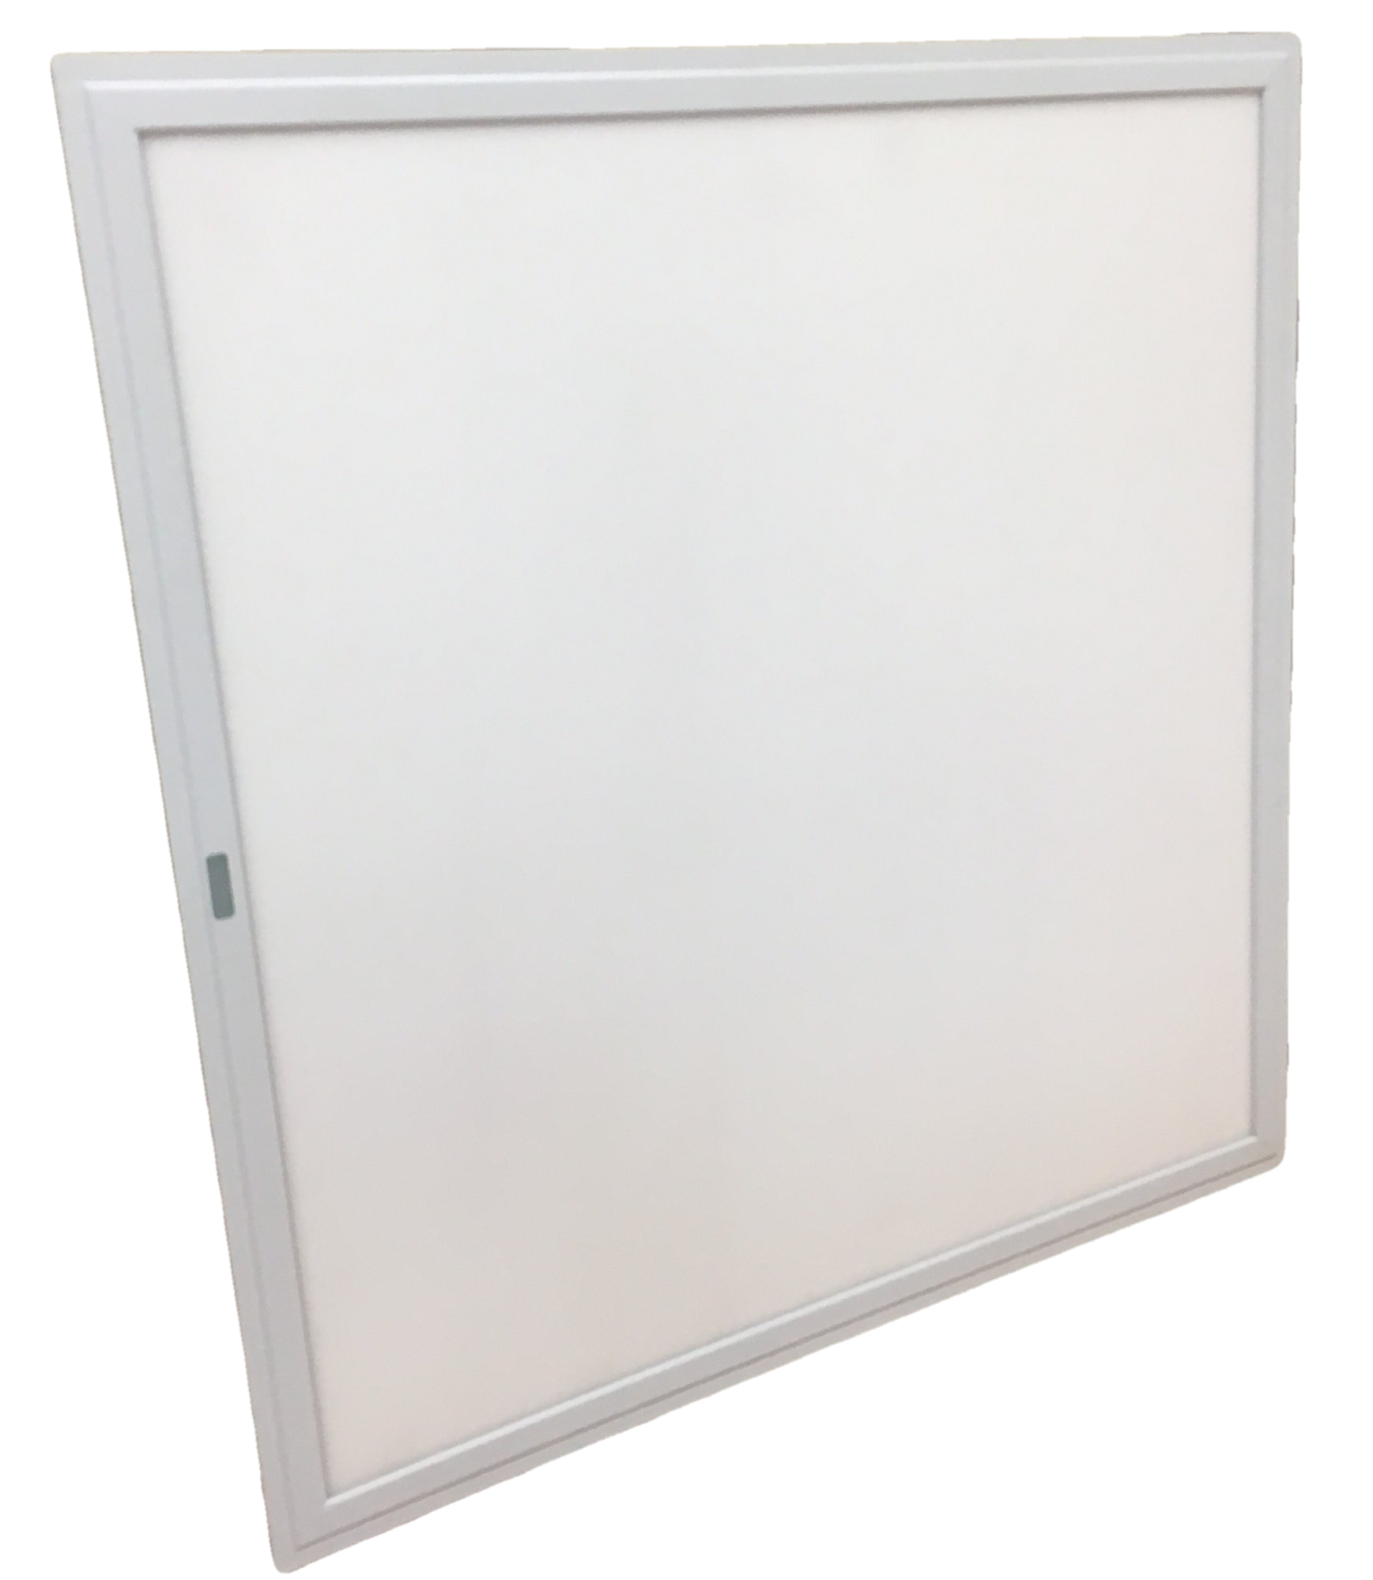
T-Bar LED Panel

Slide 3
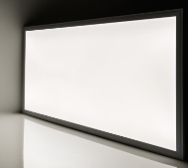
1. T-Bar 50W LED Panel
Specifications:
Size | Lumen | Efficacy | Weight | Illumination-equivalent
L1200xW300mm | 5500lm | 110lm/W | 4.9 kg | 2x32W FL T8
L600xW600mm | 5500lm | 110lm/W | 4.9 kg | 4x18W FL T8
Product Description:
+ Equipped with a 0-10V dimmable constant-current driver and an advanced optical diffuser, aluminum alloy frame, ensuring good lighting uniformity and high efficiency.
+ With built-in driver, it can be mounted directly to junction boxes.
+ Able to be operated within a wide range input voltage of AC 100-277V.
+ Able to control the brightness with a 0-10V dimmer or step-dimming driver.
With slim and elegant shape, this LED panel light is suitable for both residential and commercial sectors, replacing existing fluorescent troffer light fixtures.
Features:
Samsung LED chip
Lifespan: 50,000 hours
CCT: 5700K
Dimmable: Yes (0-10V, PWM, R)
Quality:
In compliance with UL/DLC regulations

Slide 4
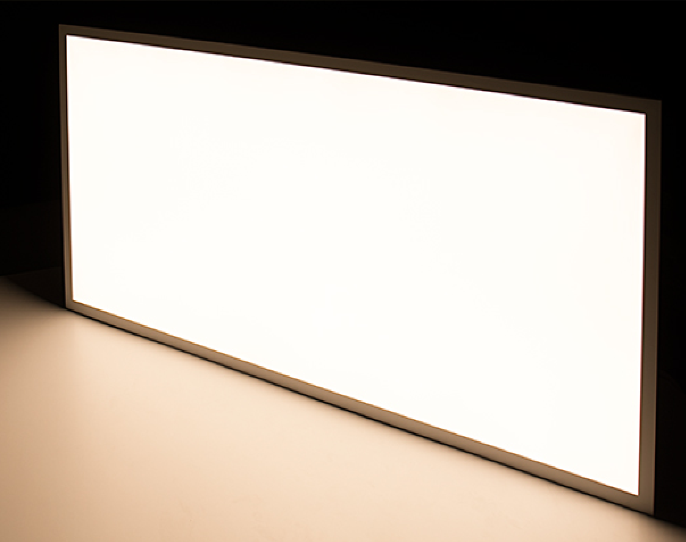
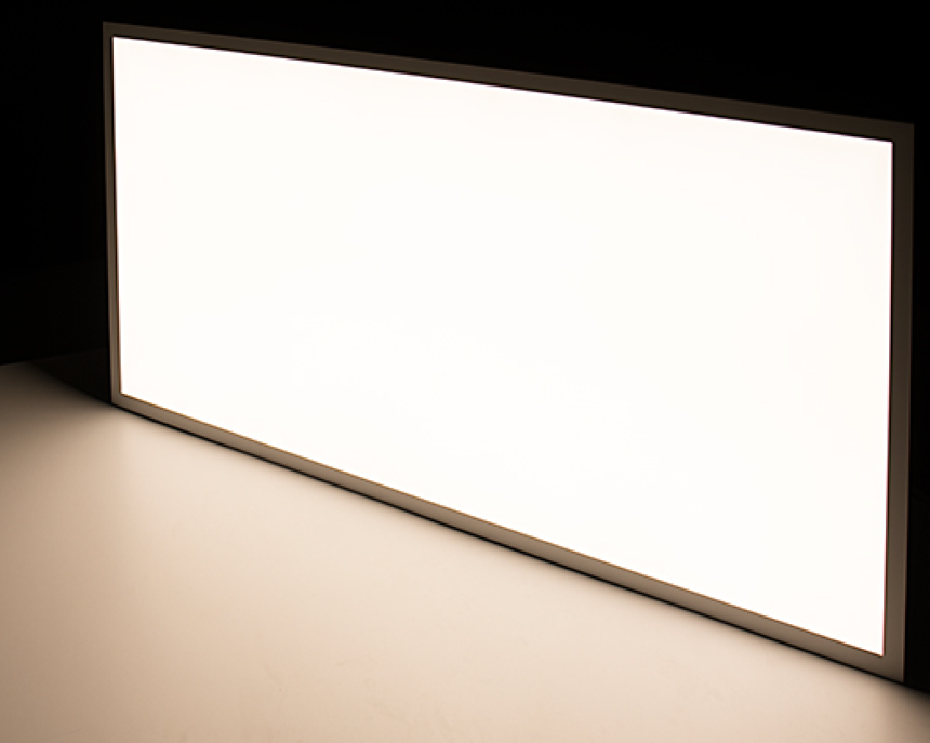
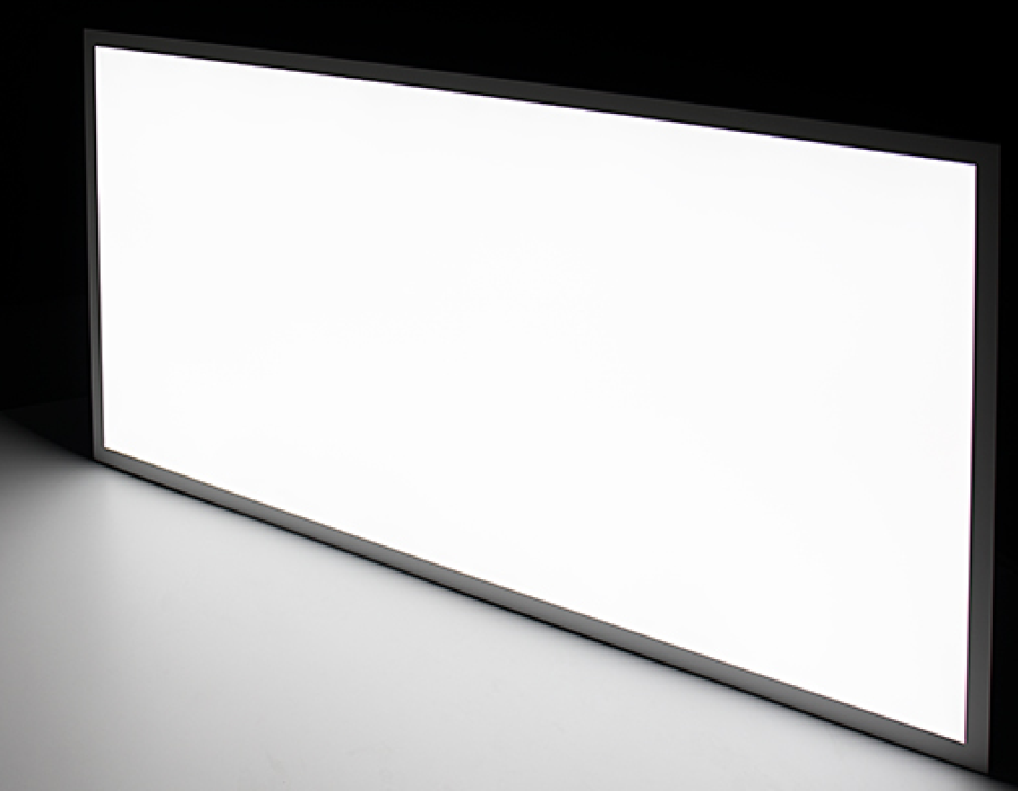
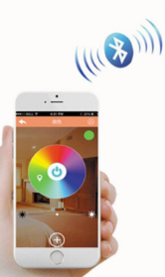
2. T-Bar 50W LED Panel (Tunable White)
Product Description:
+ Color temperature can be adjusted from 3000K to 5000K with the tunable white controller (to be sold separately).
+ Able to dim the light and change color temperature with just 1 simple touch on smartphone.
+ The 2 by 4 bi-color LED light is designed for suspended grid ceilings or can be used with a hanging kit.
+ With advanced technology and an optical diffuser, it delivers a smooth, flawless wall of illumination without visible bulbs or hot spots.
+ Its light emits up to 4,500 lumens of illumination—equivalent to the output of 4 18-watt fluorescent T8 tubes and operates within a wide input voltage range of 100-277 VAC, has a sturdy aluminum alloy frame with a white finish, and lasts 5 times longer than fluorescent lights.
This tunable-white LED Panel light is perfect for photography sector, continuous lighting, office, school, hospital lighting, gymnasium, basement, and other applications where it's beneficial to mimic natural daylight cycles
Features:
Samsung LED chip
Lifespan: 50,000 hours
CCT-Tunable: 3000/ 5700/ 6500K
Dimmable and CCT-changeable by Wifi or Bluetooth
3000K
5700K
6500K
Specifications:
Size | Lumen | Efficacy | Weight | Illumination-equivalent
L1212xW300mm | 4500lm | 90lm/W | 4.9kg | 2x32W FL T8
L600xW600mm | 4500lm | 90lm/W | 4.9kg | 4x18W FL T8

Slide 5
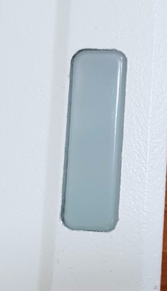
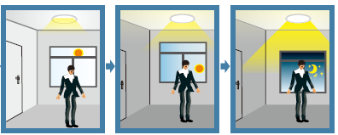
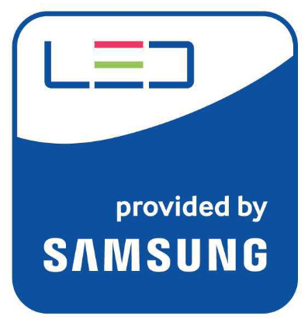
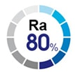
3. T-Bar LED Panel (Ambient Light Sensor)
Product Description:
The luminaire lights on 100% illumination or dims to maintain the preset illumination level against ambient light.
Sensor
Save at least 30%
of total energy
Specifications:
No. | Size | Wattage | Voltage | Frequency | PF | Lumen | Luminous Efficacy | CRI | CCT | Lifetime | Dimmable
1 | L600×W600mm | 50W | 220V | 60Hz | 0.9 | 5500lm | 110lm/W | 80 | 5700K | 25,000hrs | Yes
2 | L1200×W300mm | 50W | 220V | 60Hz | 0.9 | 5500lm | 110lm/W | 80 | 5700K | 25,000hrs | Yes

Slide 6
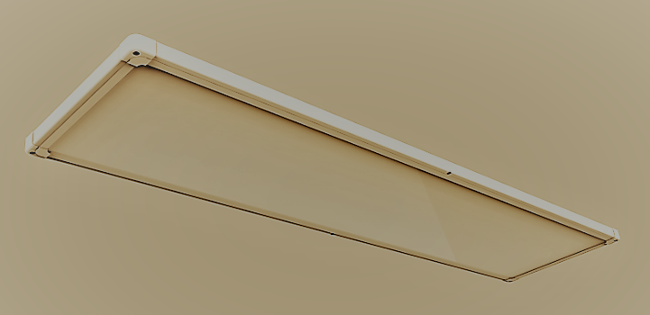
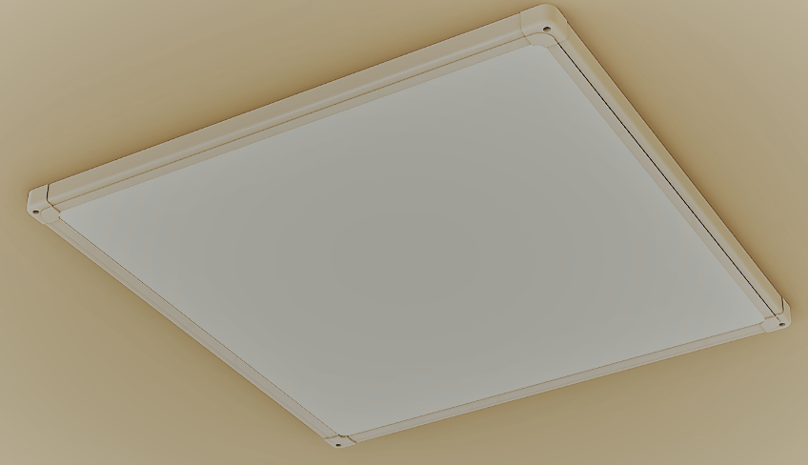
M-Bar LED Panel

Slide 7
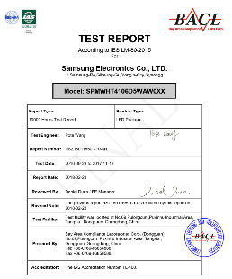
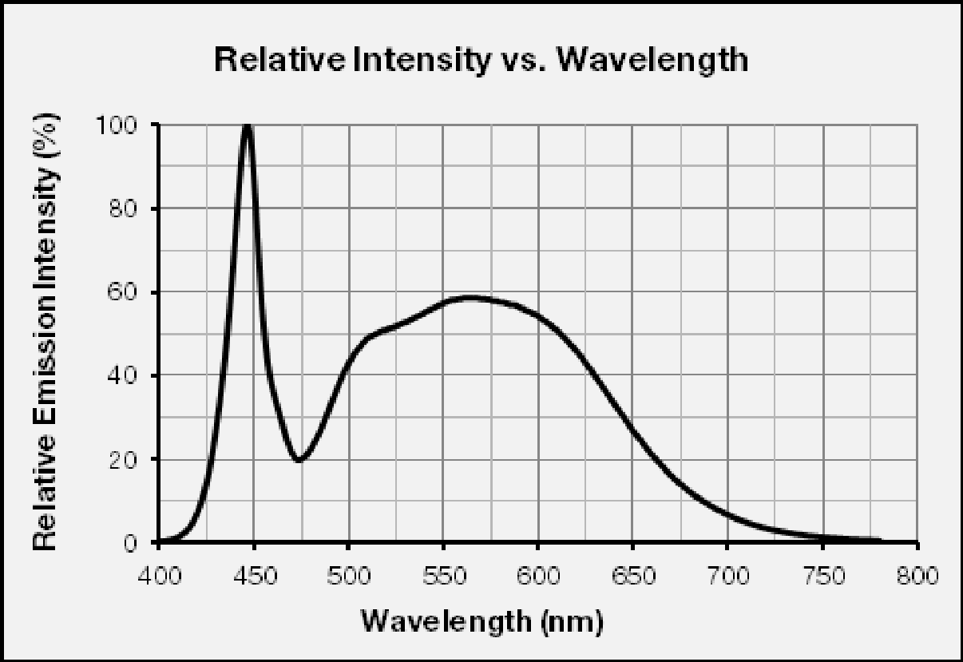
4. M-Bar LED Panel
Product Description
Rang Dong’s LED Panel light is equipped with Samsung 4014 luminous source, providing excellent lumen output, long-lasting stability and splendid sight.
5700K (80 CRI)
Low power consumption, saving more than 50%
of energy compared to existing fluorescent luminaire
Specifications:
No. | Size | Wattage | Voltage | Frequency | PF | Lumen | Luminous Efficacy | CRI | CCT | Lifetime
1 | L320xW320mm | 15W | 220V | 60Hz | 0.9 | 1200lm | 80lm/W | 80 | 5700K | 25,000hrs
2 | L640×W320mm | 25W | 220V | 60Hz | 0.9 | 2250lm | 90lm/W | 80 | 5700K | 25,000hrs
3 | L640xW180mm | 25W | 220V | 60Hz | 0.9 | 2250lm | 90lm/W | 80 | 5700K | 25,000hrs
4 | L950xW180mm | 30W | 220V | 60Hz | 0.9 | 2700lm | 90lm/W | 80 | 5700K | 25,000hrs
5 | L750xW320mm | 30W | 220V | 60Hz | 0.9 | 2700lm | 90lm/W | 80 | 5700K | 25,000hrs
6 | L1280xW180mm | 40W | 220V | 60Hz | 0.9 | 4400lm | 110lm/W | 80 | 5700K | 25,000hrs
7 | L520xW520mm | 40W | 220V | 60Hz | 0.9 | 4400lm | 110lm/W | 80 | 5700K | 25,000hrs
8 | L640×W640mm | 50W | 220V | 60Hz | 0.9 | 5500lm | 110lm/W | 80 | 5700K | 25,000hrs
9 | L1280×W320mm | 50W | 220V | 60Hz | 0.9 | 5500lm | 110lm/W | 80 | 5700K | 25,000hrs

Slide 8
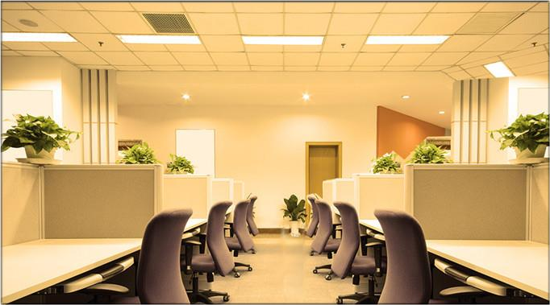
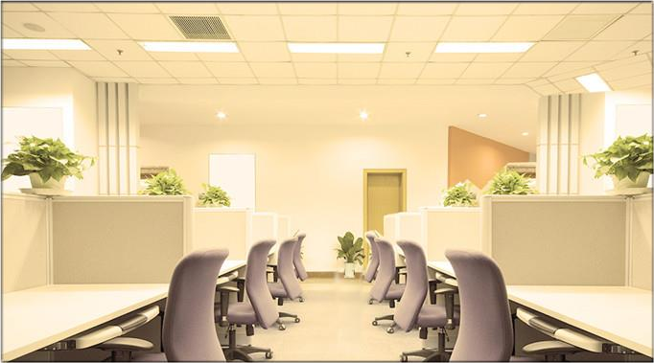
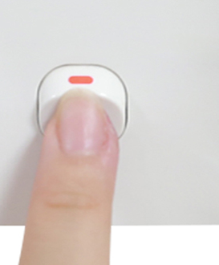
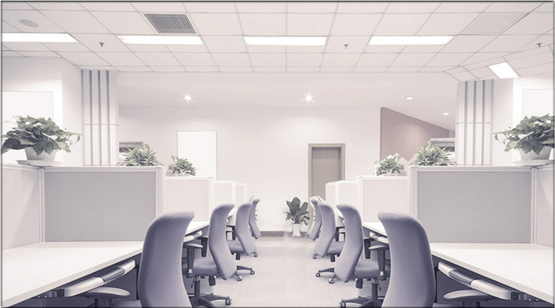
5. M-Bar LED Panel (CCT-changeable by Switch)
Features:
3000K
ON
OFF
4000K
CCT Switch
6500K
Specifications:
No. | Size | Wattage | Voltage | Frequency | PF | Lumen | Luminous Efficacy | CRI | CCT | Lifetime
1 | L320xW320mm | 15W | 220V | 60Hz | 0.9 | 1200lm | 80lm/W | 80 | 3000/4000/6500K | 25,000hrs
2 | L640×W320mm | 25W | 220V | 60Hz | 0.9 | 2250lm | 90lm/W | 80 | 3000/4000/6500K | 25,000hrs
3 | L640xW180mm | 25W | 220V | 60Hz | 0.9 | 2250lm | 90lm/W | 80 | 3000/4000/6500K | 25,000hrs
4 | L950xW180mm | 30W | 220V | 60Hz | 0.9 | 2700lm | 90lm/W | 80 | 3000/4000/6500K | 25,000hrs
5 | L750xW320mm | 30W | 220V | 60Hz | 0.9 | 2700lm | 90lm/W | 80 | 3000/4000/6500K | 25,000hrs
6 | L1280xW180mm | 40W | 220V | 60Hz | 0.9 | 3600lm | 90lm/W | 80 | 3000/4000/6500K | 25,000hrs
7 | L520xW520mm | 40W | 220V | 60Hz | 0.9 | 3600lm | 90lm/W | 80 | 3000/4000/6500K | 25,000hrs
8 | L640×W640mm | 50W | 220V | 60Hz | 0.9 | 4500lm | 90lm/W | 80 | 3000/4000/6500K | 25,000hrs
9 | L1280×W320mm | 50W | 220V | 60Hz | 0.9 | 4500lm | 90lm/W | 80 | 3000/4000/6500K | 25,000hrs

Slide 9
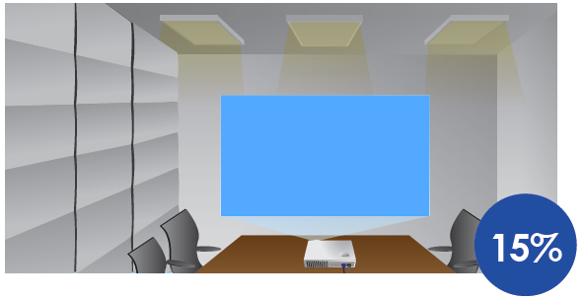
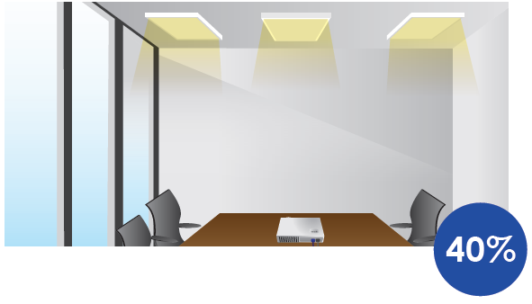
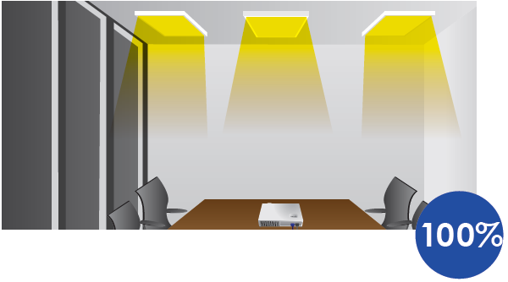
6. M-Bar LED Panel (3-Step Dimming by Switch)
Applications:
When using the projector in a meeting
When nature light is sufficient
When it is dark outside
ON
OFF
8%
34%
100%
CCT Switch
Save at least 30% of total energy
Specifications:
No. | Size | Wattage | Voltage | Frequency | PF | Lumens | Luminous Efficacy | CRI | CCT | Lifetime
1 | L320xW320mm | 15W | 220V | 60Hz | 0.9 | 1200lm | 80lm/W | 80 | 5700K | 25,000hrs
2 | L640xW320mm | 25W | 220V | 60Hz | 0.9 | 2250lm | 90lm/W | 80 | 5700K | 25,000hrs
3 | L640xW180mm | 25W | 220V | 60Hz | 0.9 | 2250lm | 90lm/W | 80 | 5700K | 25,000hrs
4 | L950xW180mm | 30W | 220V | 60Hz | 0.9 | 2700lm | 90lm/W | 80 | 5700K | 25,000hrs
5 | L750xW320mm | 30W | 220V | 60Hz | 0.9 | 2700lm | 90lm/W | 80 | 5700K | 25,000hrs
6 | L1280xW180mm | 40W | 220V | 60Hz | 0.9 | 3600lm | 90lm/W | 80 | 5700K | 25,000hrs
7 | L520xW520mm | 40W | 220V | 60Hz | 0.9 | 3600lm | 90lm/W | 80 | 5700K | 25,000hrs
8 | L640xW640mm | 50W | 220V | 60Hz | 0.9 | 4500lm | 90lm/W | 80 | 5700K | 25,000hrs
9 | L1280xW320mm | 50W | 220V | 60Hz | 0.9 | 4500lm | 90lm/W | 80 | 5700K | 25,000hrs

Slide 10
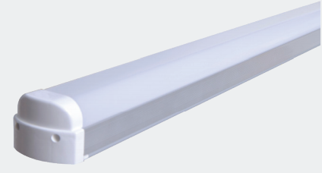
LED BATTEN LIGHT

Slide 11
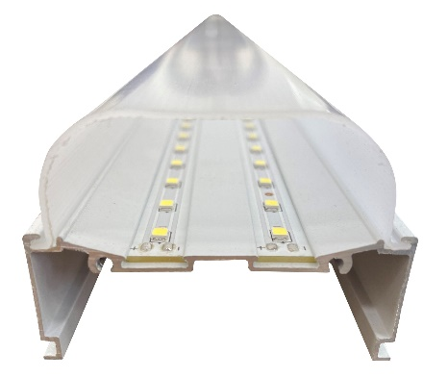
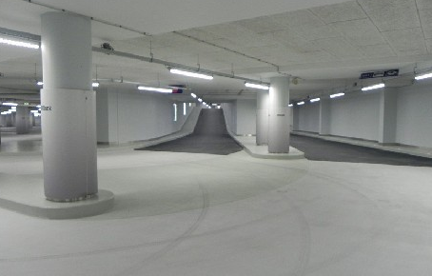
7. LED Batten light
Applications:
Parking lot, subway, commercial lighting
Apartment entrance, hallway lighting, indoor lighting
Warehouse, factory, gymnasium, etc. lighting
Features:
Low power consumption, saving more than 50% of energy compared to existing fluorescent luminaires
Uniform spread of light
Specifications:
Wattage | Size | Voltage | PF | Lumen | Luminous Efficacy | CCT | Material |  | Beam angle | LED chip | Lifetime
 |  |  |  |  |  |  | Housing | Cover
20W | L600xW60xH45mm | 220V/60Hz | 0.9 | 2200 lm | 110 | 3000K 5700K 6500K | Aluminium | PC | 110° | Samsung | 25,000hrs
40W | L1200xW60xH45mm | 220V/60Hz | 0.9 | 4400 lm | 110 |  | Aluminium | PC | 110° | Samsung | 25,000hrs
50W | L1200xW60xH45mm | 220V/60Hz | 0.9 | 5500 lm | 110 |  | Aluminium | PC | 110° | Samsung | 25,000hrs
60W | L1200xW60xH45mm | 220V/60Hz | 0.9 | 6600 lm | 110 |  | Aluminium | PC | 110° | Samsung | 25,000hrs

Slide 12
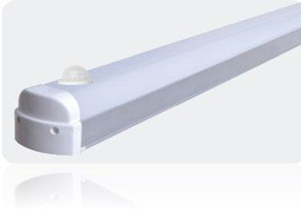
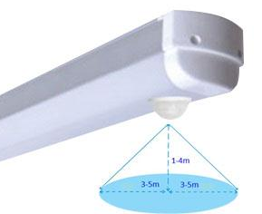
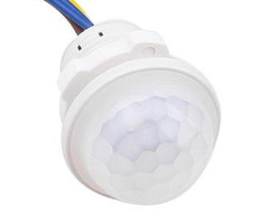
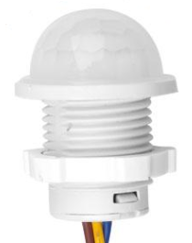
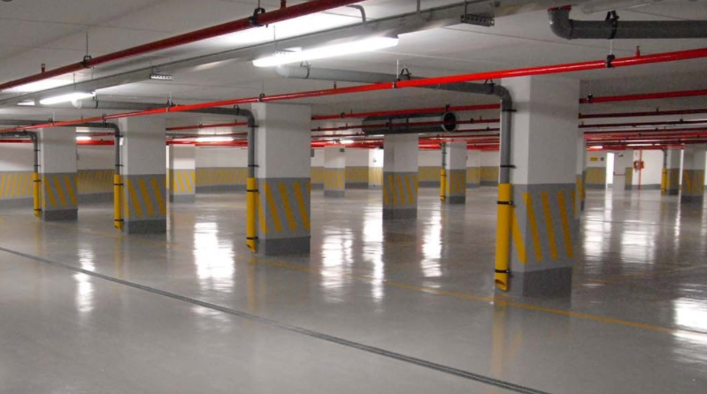
8. LED Batten light (PIR sensor/ Light sensor)
Applications:
Parking lot, subway, commercial lighting
Apartment entrance, hallway lighting, indoor lighting
Warehouse, factory, gymnasium, etc. lighting
Sensor
Features:
Sensing method: PIR Sensor + Light Sensor
Sensing distance: 3-5m
Sensing angle: 90 degree
Sensing duration: 30s
Sensing range
Specifications:
Wattage | Size | Voltage | PF | Lumen (lm) | Luminous Efficacy (lm/W) | CCT | Material |  | Beam angle | LED chip | Lifetime
 |  |  |  |  |  |  | Housing | Cover
20W | L600xW60xH45mm | 220V/60Hz | 0.9 | 2200 | 110 | 3000K 5700K 6500K | Aluminium | PC | 110° | Samsung | 25,000hrs
40W | L1200xW60xH45mm | 220V/60Hz | 0.9 | 4400 | 110 |  | Aluminium | PC | 110° | Samsung | 25,000hrs
50W | L1200xW60xH45mm | 220V/60Hz | 0.9 | 5500 | 110 |  | Aluminium | PC | 110° | Samsung | 25,000hrs
60W | L1200xW60xH45mm | 220V/60Hz | 0.9 | 6600 | 110 |  | Aluminium | PC | 110° | Samsung | 25,000hrs

Slide 13
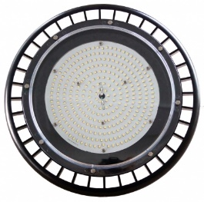
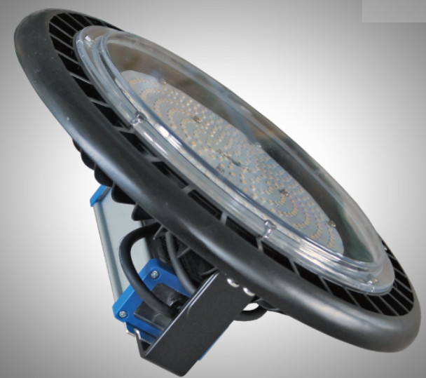
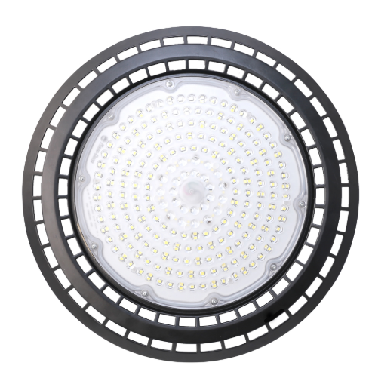
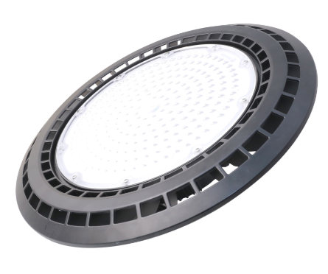
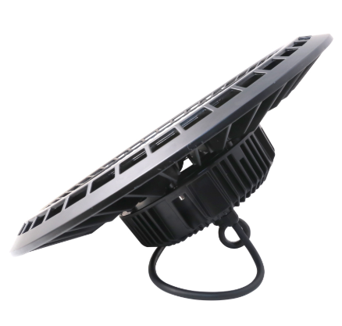
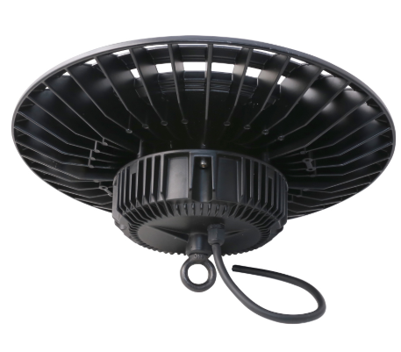
LED High Bay UFO

Slide 14
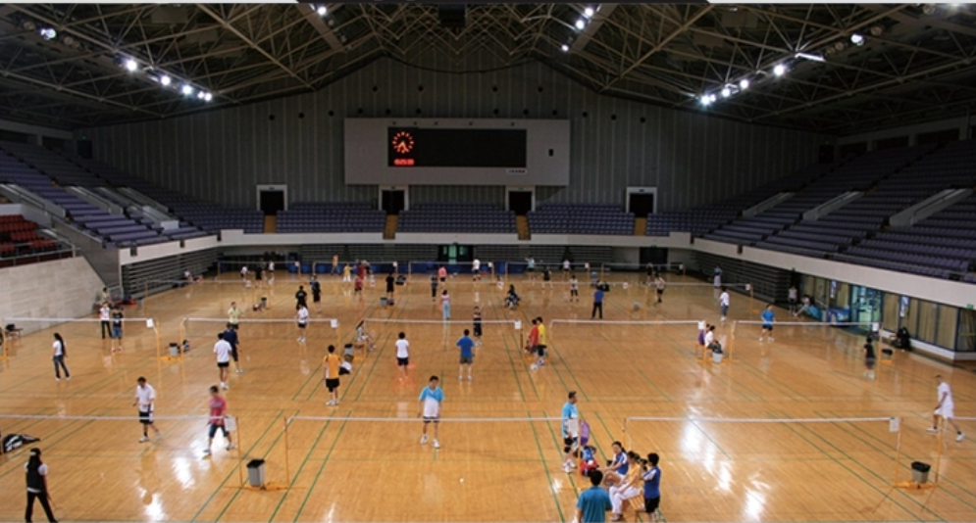
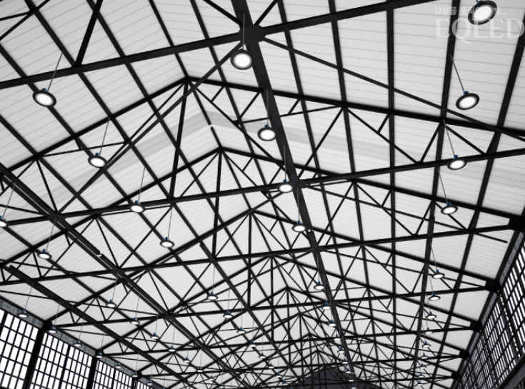
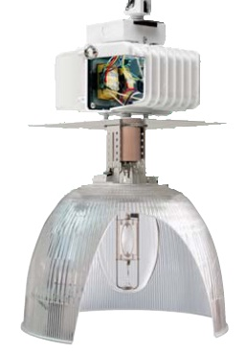
9. LED High Bay UFO
Features:
Lamp body: Die-casting aluminum
Modern design increases heat dissipation
PC optical material: high weather resistance.
IP 65: suitable for outdoor or humid locations
surge protection 6KV
Long lifetime 50,000 hrs, save maintenance costs
Flicker free
Applicable standards: IEC 60598-1, IEC 62722-2-1, EMC
Aplications:
Warehouse, workshop, indoor and outdoor sport stadium, tunnel lighting.
Compare:
 | LED High bay | HID High bay
Energy used | 100W | 200W
Energy used | 150W | 300W
Efficacy | 130 lm/W | 80 lm/W
Life time (hrs) | 50,000 | 15,000
Warranty | 3 ~ 5 years | 1 years
Specifications:
No. | Size (ΦxH-mm) | Power (W) | Voltage/ Frequency | PF | Lumens (lm) | Efficacy (lm/W) | CRI | CCT (k) | Weight (kg) | Life time | Beam angle
1 | 330x142 | 100 | 100 - 277V/ 50-60Hz | 0.95 | 13000 | 130 | 80 | 3000/5000/ 6500 | 3.1 | 50,000 | 110°
2 | 330x142 | 150 | 100 - 277V/ 50-60Hz | 0.95 | 19500 | 130 | 80 |  | 3.3 | 50,000 | 110°

Slide 15
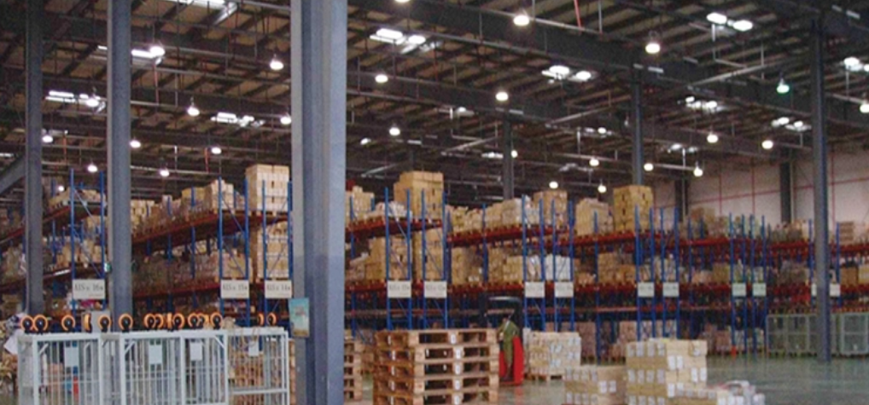
10. LED High Bay UFO
Aplications:
Features:
Warehouse, workshop, indoor and outdoor sport stadium, tunnel lighting.
Lamp body: Die-casting aluminum
Modern design increases heat dissipation
PC optical material: high weather resistance.
IP 65: suitable for outdoor or humid locations
surge protection 6KV
Long lifetime 50,000 hrs, save maintenance costs
Flicker free
Applicable standards: IEC 60598-1, IEC 62722-2-1, EMC
Specifications:
Size (ΦxH-mm) | Power (W) | Voltage/ Frequency | PF | Lumens (lm) | Efficacy (lm/W) | CRI | CCT (k) | Weight (kg) | Life time | Beam angle
390x160 | 200 | 100 - 305V/ 50-60Hz | 0.95 | 26000 | 130 | 80 | 3000/5000/ 6500 | 4.5 | 50,000 | 110°

Slide 16
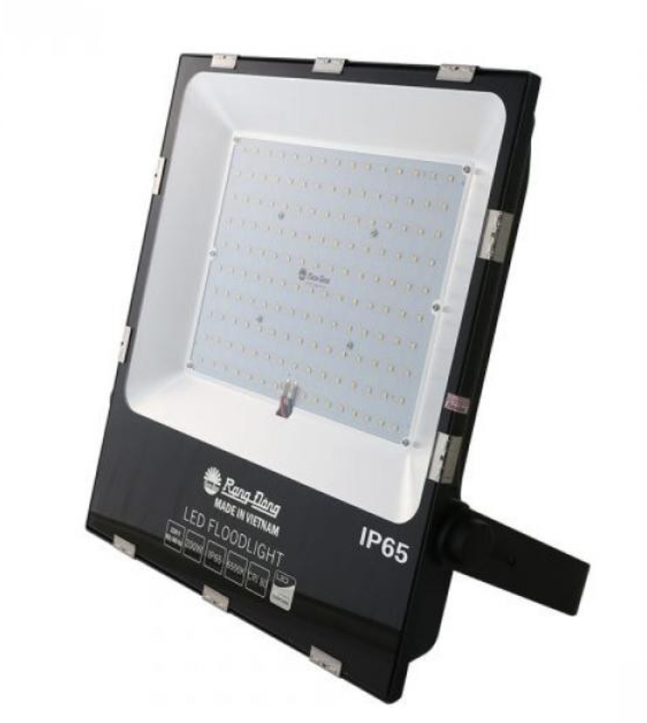
LED Flood light

Slide 17
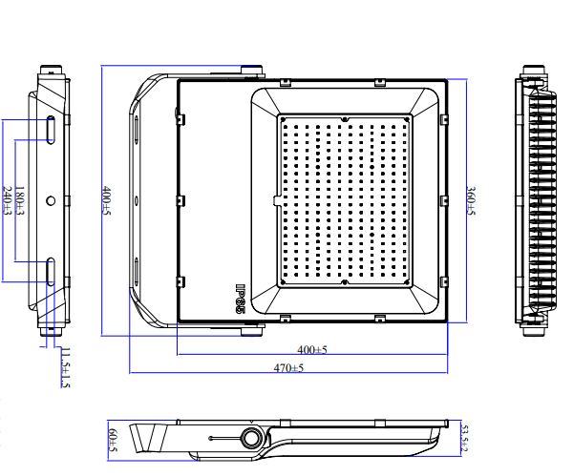
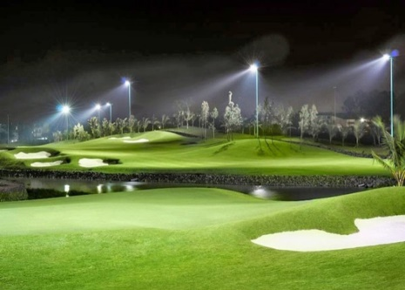
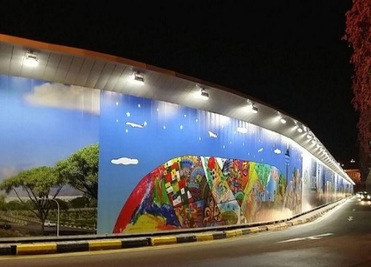
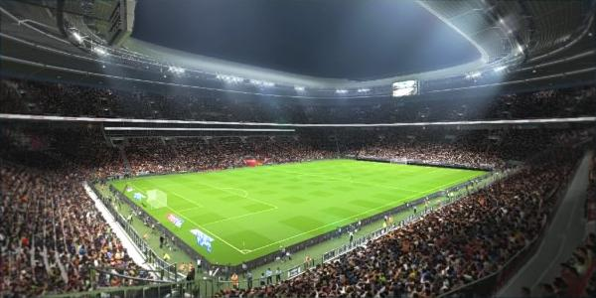
11. LED Flood light
Applications:
Used in Suitable for large lighting space like: squares, areas around buildings, public works, gardens, etc
Product Feature:
IP 65 protection, suitable for indoor and outdoor use
Adjustable bracket: 270degree adjustable bracket to fit for different direction installation.
Surge protection 10KV
Lifetime: 30,000 (hrs), saving maintenance cost
Heatsink: Die-casting aluminum ADC12
Applied standard: IEC 60598-2-5, EMC
Specifications:
Model | Power (W) | Voltage (V) | PF | Lumens (lm) | Efficacy (lm/W) | CCT (K) | CRI (Ra) | Size (mm) | Life time (hour) | Unit price FOB | MOQ
D CP06L 200W | 200 | 100 – 277 50/60Hz | 0.9 | 20,000 | 100 | 3000/5000 6500 | 80 | 400*360*60 | 30,000

Slide 18
THANK YOU!
Website: rangdong.com.vn
Telephone: (+84) 24 38 584 310 / 38 584 165
Email: export@rangdong.com.vn

