Slide 1
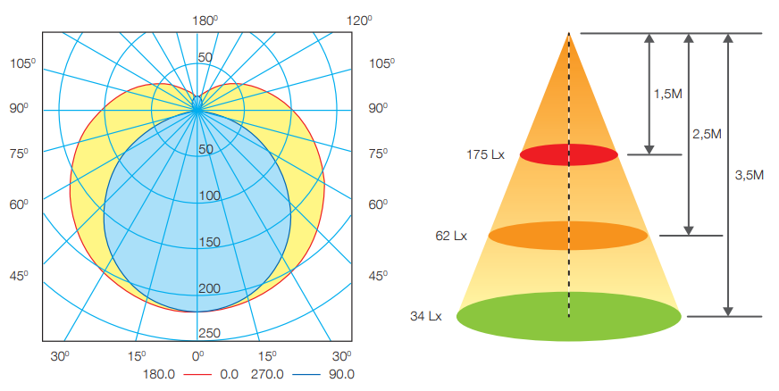
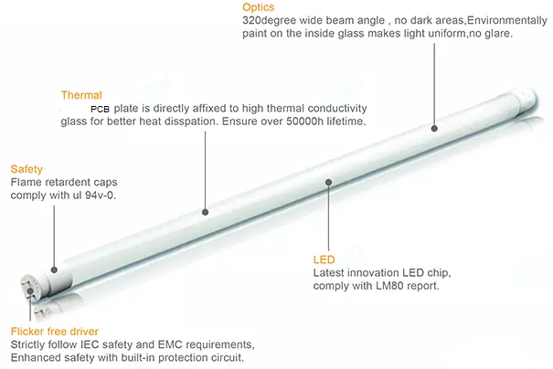
1. LED Glass Tube
Polar Diagram Comparison
Feature
High-quality powder coating: strong color rendering, low light decay, not easy to change color
Constant current driver
Lamp head: impact resistant, high temperature resistant, flame retardant
Applied standard: IEC 62776
Packing: Foam, 25 pcs/carton
Specifications
Model | Power | Size (D×L)mm | Voltage | PF | Lumens (lm) ±10% | Efficacy (lm/W) | CCT (K) | Ra | Cap | Body Material | Life time (hour) | FOB Haiphong port, Vietnam (USD)
 |  |  |  |  |  |  |  |  |  |  |  | MOQ 10K pcs | MOQ 20K pcs
LED Glass Tube 130lm/W | 10W | 26×603 | 150 – 250 50/60Hz | 0.5 | 1300 | 130 | 3000/ 6500 | > 80 | PC, G13 | Glass | 20,000
 | 20W | 26×1213 | 150 – 250 50/60Hz | 0.5 | 2600 | 130 | 3000/ 6500 | > 80 | PC, G13 | Glass | 20,000
LED Glass Tube 110lm/W | 10W | 26×603 | 150 – 250 50/60Hz | 0.5 | 1100 | 110 | 3000/ 6500 | > 80 | PC, G13 | Glass | 20,000
 | 20W | 26×1213 | 150 – 250 50/60Hz | 0.5 | 2200 | 110 | 3000/ 6500 | > 80 | PC, G13 | Glass | 20,000

Slide 2
2. LED Glass Tube EMC
Polar Diagram Comparison
Feature
High-quality powder coating: strong color rendering, low light decay, not easy to change color
Constant current driver
Lamp head: impact resistant, high temperature resistant, flame retardant
Applied standard: IEC 62776
Packing: Foam, 25pcs/carton
Specifications
Model | Power | Size (D×L)mm | Voltage | PF | Lumens (lm) ±10% | Efficacy (lm/W) | CCT (K) | Ra | Cap | Body Material | Life time (hour) | FOB Haiphong port, Vietnam (USD)
 |  |  |  |  |  |  |  |  |  |  |  | MOQ 10K pcs | MOQ 20K pcs
LED Glass Tube EMC, Surge 1.5kV | 10W | 26×603 | 150 – 250 50/60Hz | 0.5 | 1100 | 110 | 3000/ 6500 | > 80 | PC, G13 | Glass | 20,000
 | 20W | 26×1213 | 150 – 250 50/60Hz | 0.5 | 2200 | 110 | 3000/ 6500 | > 80 | PC, G13 | Glass | 20,000

Slide 3
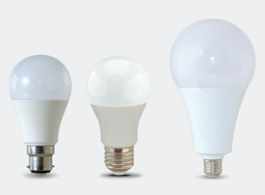
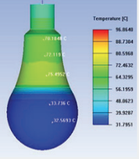
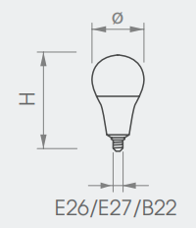
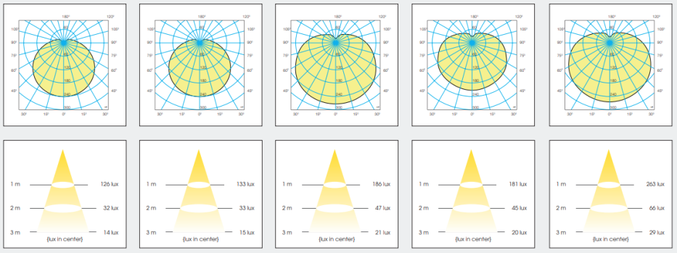
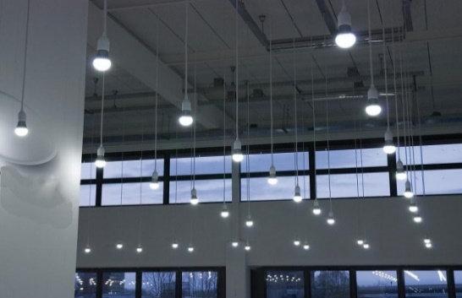
3. BULB A
Feature
Replacement of incandescent and compact fluorescent lamp.
70% energy savings compared to existing incandescent bulbs.
Eco-friendly, no mercury, no UV or IR Radiation
Safety use, flicker free
Wide-angle light distribution
Applied standard: IEC 62560 & IEC 62612
Application:
Hotel, office, meeting room, show room, shop, supermarket, living room, kitchen and other commercial places.
Packing: 50pcs/carton
7W
9W
12W
15W
20W
Specifications
Model | Power (W) | Size (D×L) mm | Voltage | PF | Lumens (lm) ±10% | Efficacy (lm/W) | CCT (K) | Ra | Cap | Body Material | Life time (hour) | FOB Haiphong port, Vietnam (USD)
 |  |  |  |  |  |  |  |  |  |  |  | MOQ 10K pcs
A55 5W | 5 | 55×101 | 150 – 250 50/60Hz | 0.5 | 450 | 90 | 3000/6500 /7500 | > 80 | E27 | PC | 10,000
A60 7W | 7 | 60×111 | 150 – 250 50/60Hz | 0.5 | 630 | 90 | 3000/6500 /7500 | > 80 | E27 | AL-PC | 15,000
A60 9W | 10 | 60×111 | 150 – 250 50/60Hz | 0.5 | 830 | 92 | 3000/6500 /7500 | > 80 | E27 | AL-PC | 15,000
A65 12W | 12 | 65x126 | 150 – 250 50/60Hz | 0.5 | 1080 | 90 | 3000/6500 /7500 | > 80 | E27 | AL-PC | 15,000
A70 15W | 15 | 70x138 | 150 – 250 50/60Hz | 0.5 | 1380 | 92 | 3000/6500 /7500 | > 80 | E27 | AL-PC | 15,000
A80 18W | 20 | 80×155 | 150 – 250 50/60Hz | 0.5 | 1900 | 95 | 3000/6500 /7500 | > 80 | E27 | AL-PC | 15,000

Slide 4
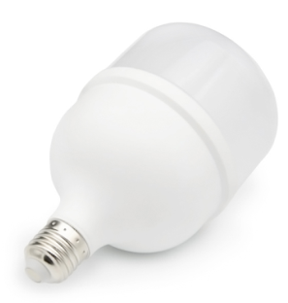
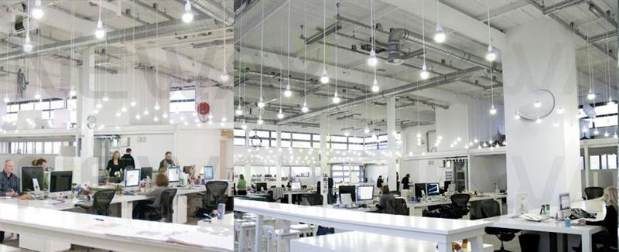
1. BULB T
Application:
Hotel, office, meeting room, show room, shop, supermarket, living room, kitchen and other commercial places.
Feature
Replacement of incandescent and compact fluorescent lamp.
70% energy savings compared to existing incandescent bulbs.
Eco-friendly, no mercury, no UV or IR Radiation
Safety use, flicker free
Wide-angle light distribution
Multiple color temperature available: 3000K, 6500K, 8000K,10000K, 12000K
Applied standard: IEC 62560 & IEC 62612
Specifications
Model | Power (W) | Size (ɸ×H) mm | Voltage | PF | Lumens (lm) | Efficacy (lm/W) | CCT (K) | Ra | Cap | Body Material | Life time (hour) | Price (USD)
 |  |  |  |  |  |  |  |  |  |  |  | MOQ 5K pcs | MOQ 10K pcs
T80 20W | 20 | 80×145 | 150 – 250 50/60Hz | 0.5 | 1900 | 95 | 3000/ 6500/ 8000/ 10000/ 12000 | > 80 | E27/ B22 | AL-PC | 15,000
T100 30W | 30 | 100×185 | 150 – 250 50/60Hz | 0.5 | 2850 | 95 |  | > 80 | E27/ B22 | AL-PC | 15,000
T120 40W | 40 | 120×210 | 150 – 250 50/60Hz | 0.5 | 3800 | 95 |  | > 80 | E27/ B22 | AL-PC | 15,000
T140 50W | 50 | 140x240 | 150 – 250 50/60Hz | 0.5 | 4750 | 95 |  | > 80 | E27/ B22 | AL-PC | 15,000

Slide 5
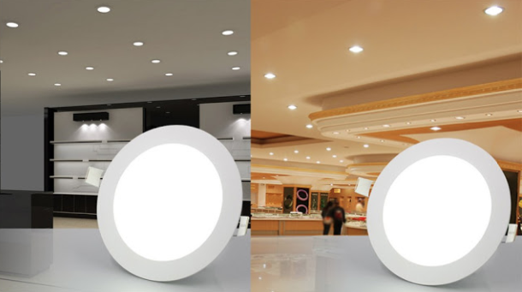
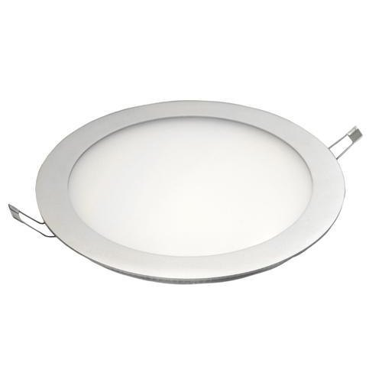
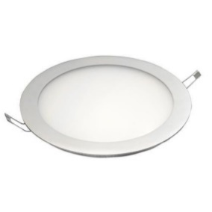
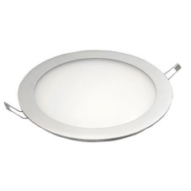
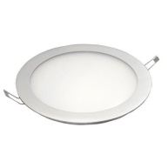
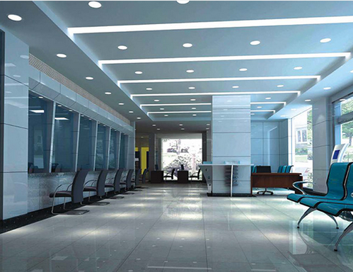
4. SLIM ROUND PANEL
Application:
hotel, office, meeting room, show room, shop, hospital, supermarket, bathroom, bedrooms, living room, kitchen and other commercial places.
Feature
Thin and strong aluminum alloy frame structure and not easily deformed
Easy and quick installation to save labor costs
No flicker to protect human eyes
High CRI > 80 ensures more vivid and natural light
Environment friendly: No lead or mercury and No UV or IR Radiation
Long life time 35,000 hrs
Specifications
Model | Power (W) | Size (D×L) mm | Cut hole (mm) | Voltage (V) | PF | Lumens (lm) 10% | CCT (K) | Ra | Beam angle (º) | IP | Life time (hours) | FOB Haiphong port, Vietnam (USD)
 |  |  |  |  |  |  |  |  |  |  |  | MOQ 10K pcs
PN 80/3W | 3 | 80×14 | 70 | 100 – 265 50/60Hz | 0.5 | 160 | 3000/4000/ 6500 | > 80 | 110 | 20 | 35,000
PN 120/6W | 6 | 120×14 | 105 | 100 – 265 50/60Hz | 0.5 | 420 | 3000/4000/ 6500 | > 80 | 110 | 20 | 35,000
PN 145/9W | 9 | 145×14 | 130 | 100 – 265 50/60Hz | 0.5 | 660 | 3000/4000/ 6500 | > 80 | 110 | 20 | 35,000
PN 170/12W | 12 | 170x14 | 155 | 100 – 265 50/60Hz | 0.5 | 1050 | 3000/4000/ 6500 | > 80 | 110 | 20 | 35,000
PN 225/18W | 18 | 225x14 | 210 | 100 – 265 50/60Hz | 0.5 | 1720 | 3000/4000/ 6500 | > 80 | 110 | 20 | 35,000

Slide 6
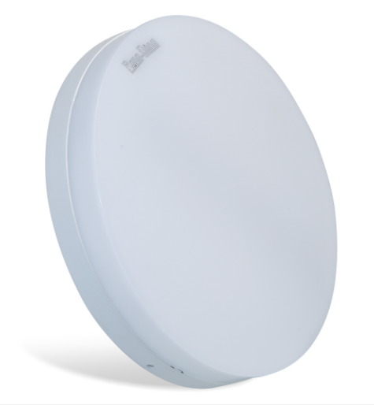
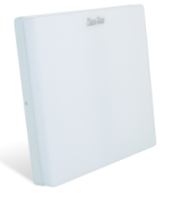
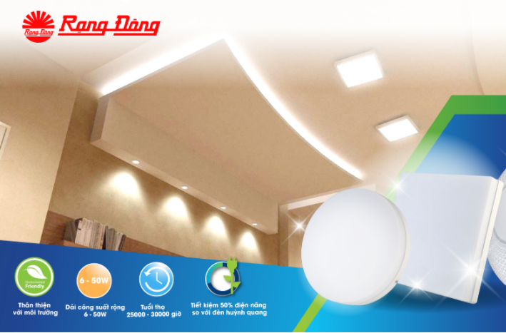
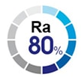
LED Ceiling Light _ Serie LN12
Features:
Eco-friendly: No mercury, less CO₂ emissions, no UV/IR
Complied with RoHS standard
Easy to install and maintain
Lifetime: 25,000 (hrs), saving maintenance cost
Applied standard: IEC 60598-1, IEC 62722-2-1, EMC
ROUND 12/18/24W
Application:
Residence, living room, hallway, office
Bar, cafe, clothing store, etc
SQUARE 12/18/24W
Specifications:
Model | Size (mm) | Power (W) | Voltage/ Frequency | Lumen (lm) | Efficacy (lm/W) | CRI (Ra) | CCT (K) | PF | IP | Life time (hrs) | Material | FOB Haiphong(USD/pc)
LN12N 170/12W | 160x36 | 12 | 150 - 250V/ 50-60Hz | 900/810 | 75/68 | 80 | 6500/ 3000 | 0.5 | 54 | 25,000 | PC
LN12N 170x170/12W | 160x160x36
LN12N 220/18W | 220x36 | 18 | 150 - 250V/ 50-60Hz | 1400/ 1260 | 78/70 | 80 | 6500/ 3000 | 0.5 | 54 | 25,000 | PC
LN12N 220x220/18W | 220x220x36
LN12N 300/24W | 280x36 | 24 | 150 - 250V/ 50-60Hz | 2000/ 1800 | 83/75 | 80 | 6500/ 3000 | 0.5 | 54 | 25,000 | PC
LN12N 300x300/24W | 280x280x36

