Slide 1
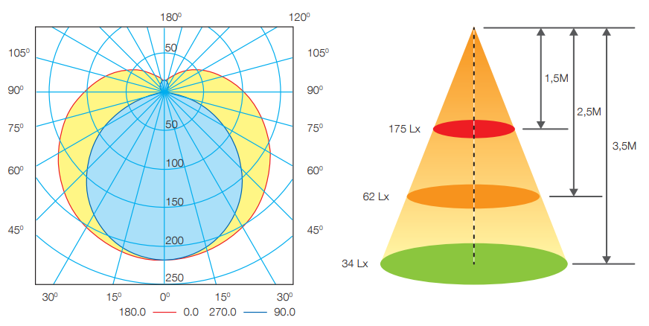
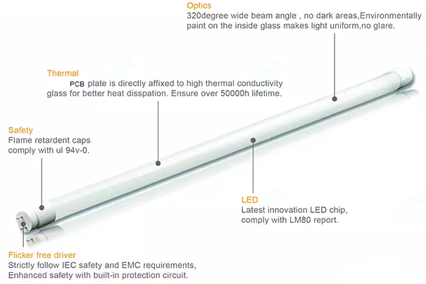
1. LED Glass Tube
Polar Diagram Comparison
Feature
High-quality powder coating: strong color rendering, low light decay, not easy to change color
Constantly stable current driver
Lamp head: hitting resistant, high temperature resistant, flame retardant
Applied standard: IEC 62776
Packing: Foam, 25 pcs/carton
Specifications
Model | Power | Size (D×L)mm | Voltage | PF | Lumens (lm) ±10% | Efficacy (lm/W) | CCT (K) | Ra | Cap | Body Material | Life time (hour) | FOB Haiphong port, Vietnam (USD)
 |  |  |  |  |  |  |  |  |  |  |  | MOQ 10K pcs | MOQ 20K pcs
LED Glass Tube 130lm/W | 10W | 26×603 | 150 – 250 50/60Hz | 0.5 | 1300 | 130 | 3000/ 6500 | > 80 | PC, G13 | Glass | 20,000
 | 20W | 26×1213 | 150 – 250 50/60Hz | 0.5 | 2600 | 130 | 3000/ 6500 | > 80 | PC, G13 | Glass | 20,000
LED Glass Tube 110lm/W | 10W | 26×603 | 150 – 250 50/60Hz | 0.5 | 1100 | 110 | 3000/ 6500 | > 80 | PC, G13 | Glass | 20,000
 | 20W | 26×1213 | 150 – 250 50/60Hz | 0.5 | 2200 | 110 | 3000/ 6500 | > 80 | PC, G13 | Glass | 20,000

Slide 2
2. LED Glass Tube EMC
Polar Diagram Comparison
Feature
High-quality powder coating: strong color rendering, low light decay, not easy to change color
Constantly stable current driver
Lamp head: hitting resistant, high temperature resistant, flame retardant
Applied standard: IEC 62776
Packing: Foam, 25pcs/carton
Specifications
Model | Power | Size (D×L)mm | Voltage | PF | Lumens (lm) ±10% | Efficacy (lm/W) | CCT (K) | Ra | Cap | Body Material | Life time (hour) | FOB Haiphong port, Vietnam (USD)
 |  |  |  |  |  |  |  |  |  |  |  | MOQ 10K pcs | MOQ 20K pcs
LED Glass Tube EMC, Surge 1.5kV | 10W | 26×603 | 150 – 250 50/60Hz | 0.5 | 1100 | 110 | 3000/ 6500 | > 80 | PC, G13 | Glass | 20,000
 | 20W | 26×1213 | 150 – 250 50/60Hz | 0.5 | 2200 | 110 | 3000/ 6500 | > 80 | PC, G13 | Glass | 20,000

Slide 3
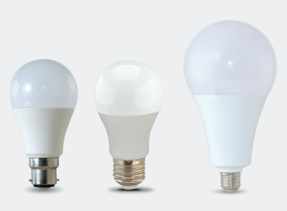
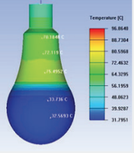
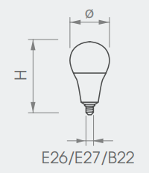
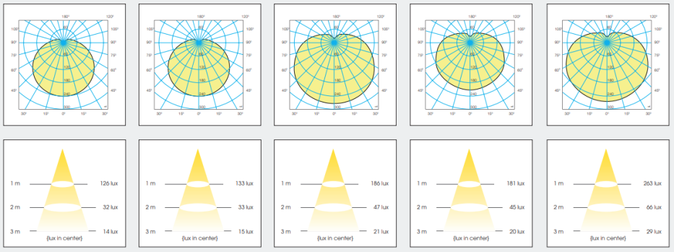
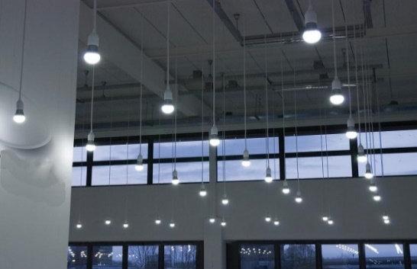
3. BULB A
Feature
Replacement of incandescent and compact fluorescent lamp.
70% energy savings compared to existing incandescent bulbs.
Eco-friendly, no mercury, no UV or IR Radiation
Safe use, flicker free
Wide-angle light distribution
Applied standard: IEC 62560 & IEC 62612
Application:
Hotel, office, meeting room, show room, shop, supermarket, living room, kitchen and other commercial places.
Packing: 50pcs/carton
7W
9W
12W
15W
20W
Specifications
Model | Power (W) | Size (D×L) mm | Voltage | PF | Lumens (lm) ±10% | Efficacy (lm/W) | CCT (K) | Ra | Cap | Body Material | Life time (hour) | FOB Haiphong port, Vietnam (USD)
 |  |  |  |  |  |  |  |  |  |  |  | MOQ 10K pcs
A55 5W | 5 | 55×101 | 150 – 250 50/60Hz | 0.5 | 450 | 90 | 3000/6500 /7500 | > 80 | E27 | PC | 10,000
A60 7W | 7 | 60×111 | 150 – 250 50/60Hz | 0.5 | 630 | 90 | 3000/6500 /7500 | > 80 | E27 | AL-PC | 15,000
A60 9W | 10 | 60×111 | 150 – 250 50/60Hz | 0.5 | 830 | 92 | 3000/6500 /7500 | > 80 | E27 | AL-PC | 15,000
A65 12W | 12 | 65x126 | 150 – 250 50/60Hz | 0.5 | 1080 | 90 | 3000/6500 /7500 | > 80 | E27 | AL-PC | 15,000
A70 15W | 15 | 70x138 | 150 – 250 50/60Hz | 0.5 | 1380 | 92 | 3000/6500 /7500 | > 80 | E27 | AL-PC | 15,000
A80 18W | 20 | 80×155 | 150 – 250 50/60Hz | 0.5 | 1900 | 95 | 3000/6500 /7500 | > 80 | E27 | AL-PC | 15,000

Slide 4
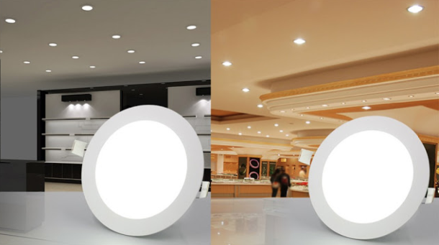
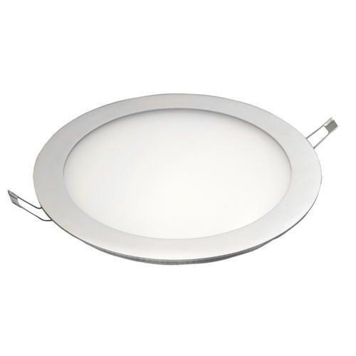
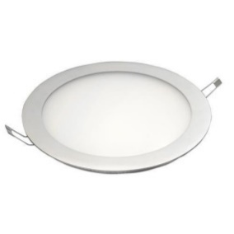
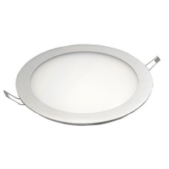
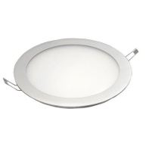
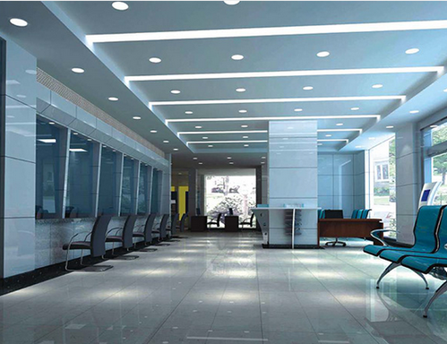
4. SLIM ROUND PANEL
Application:
hotel, office, meeting room, show room, shop, hospital, supermarket, bathroom, bedrooms, living room, kitchen and other commercial places.
Feature
Thin and strong aluminum alloy frame structure and not easily deformed
Easy and quick installation to save labor costs
No flicker to protect human eyes
High CRI > 80 ensures more vivid and natural light
Environment friendly: No lead or mercury and No UV or IR Radiation
Long lifetime : 35,000 hrs
Specifications
Model | Power (W) | Size (D×L) mm | Cut hole (mm) | Voltage (V) | PF | Lumens (lm) 10% | CCT (K) | Ra | Beam angle (º) | IP | Life time (hours) | FOB Haiphong port, Vietnam (USD)
 |  |  |  |  |  |  |  |  |  |  |  | MOQ 10K pcs
PN 80/3W | 3 | 80×14 | 70 | 100 – 265 50/60Hz | 0.5 | 160 | 3000/4000/ 6500 | > 80 | 110 | 20 | 35,000
PN 120/6W | 6 | 120×14 | 105 | 100 – 265 50/60Hz | 0.5 | 420 | 3000/4000/ 6500 | > 80 | 110 | 20 | 35,000
PN 145/9W | 9 | 145×14 | 130 | 100 – 265 50/60Hz | 0.5 | 660 | 3000/4000/ 6500 | > 80 | 110 | 20 | 35,000
PN 170/12W | 12 | 170x14 | 155 | 100 – 265 50/60Hz | 0.5 | 1050 | 3000/4000/ 6500 | > 80 | 110 | 20 | 35,000
PN 225/18W | 18 | 225x14 | 210 | 100 – 265 50/60Hz | 0.5 | 1720 | 3000/4000/ 6500 | > 80 | 110 | 20 | 35,000

