Slide 1
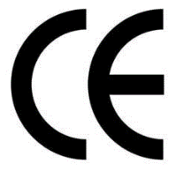
Only presentation for Professional Customer
www.rangdong.com.vn

Slide 2
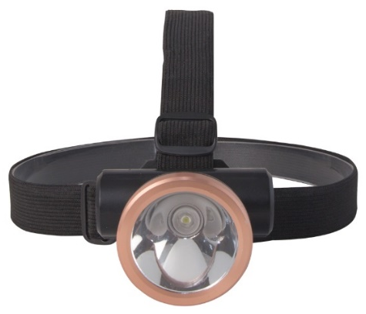
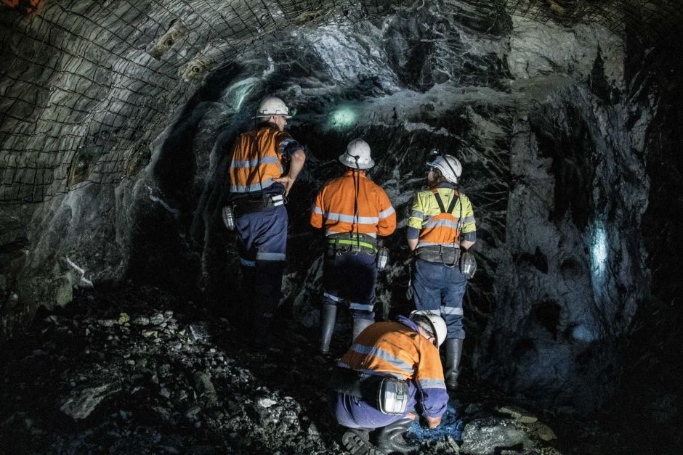
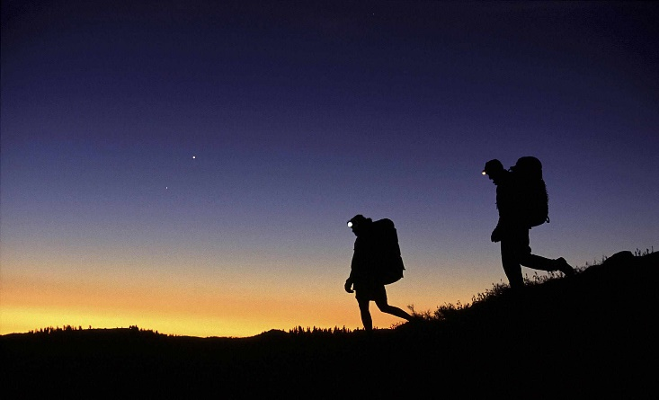
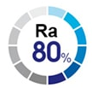
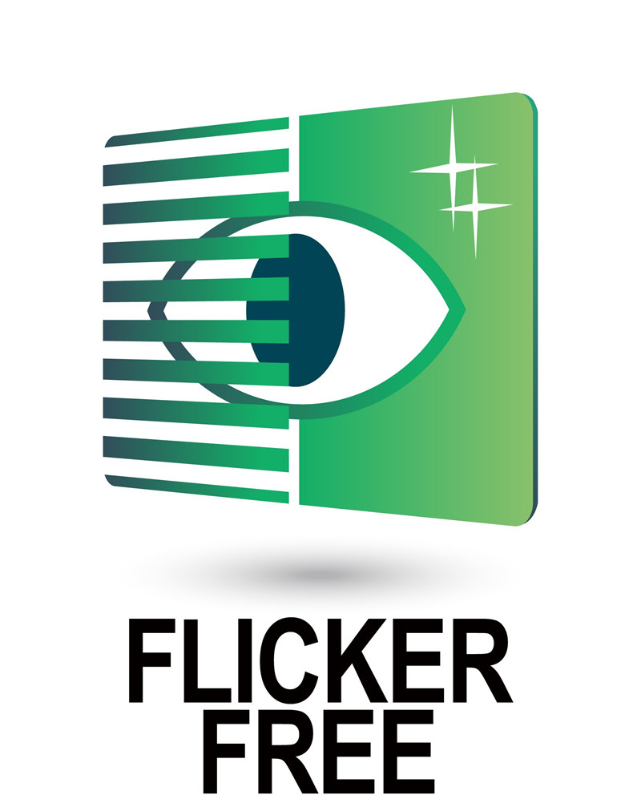
HEADBAND LIGHT
Application:
Great for Biking, Hiking, Working
Features:
High-quality LED packaging use with long lifespan and high luminous efficiency
Body material: high-grade plastic
Non ultraviolet radiation, safe for users, eco-friendly.
One Button with 3 brightness level settings: ON 1 (50%) – ON 2 (100%) - OFF
Comfortable adjustable elastic headband
Adjustable angle
Free up your hands, no need to hold a flashlight
Suitable to work in small dark spaces
Specifications:
Model | Power (W) | Voltage/ Frequency | Battery capacity (mA.h) | Lighting time (hrs) | Full charging time (hrs) | Light level | Body material | Mass (g)
D PDD03L/1W | 1 | 100 - 240V/ 50-60Hz | 2000 | 5-12 | 12 | 2 | PC | 93
D PDD03L/3W | 3 | 100 - 240V/ 50-60Hz | 2000 | 5-12 | 12 | 2 | PC | 101
D PDD03L/5W | 5 | 100 - 240V/ 50-60Hz | 2400 | 5-12 | 12 | 2 | PC | 203

Slide 3
THANK YOU!

