Slide 1
Only presentation for Professional Customer
www.rangdong.com.vn

Slide 2
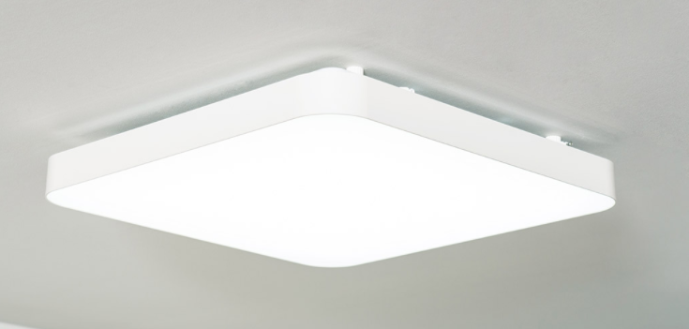
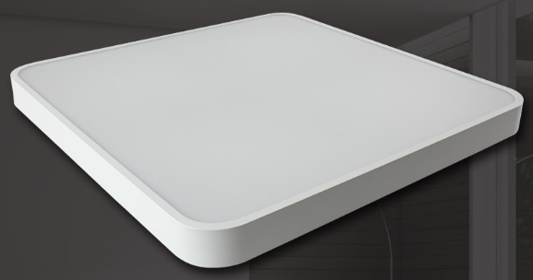
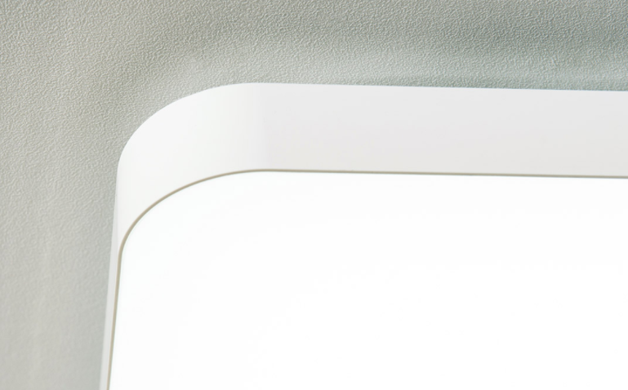
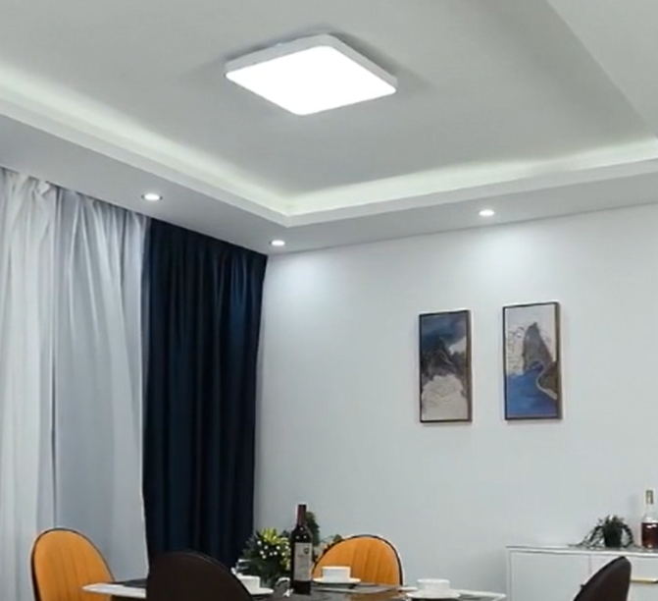
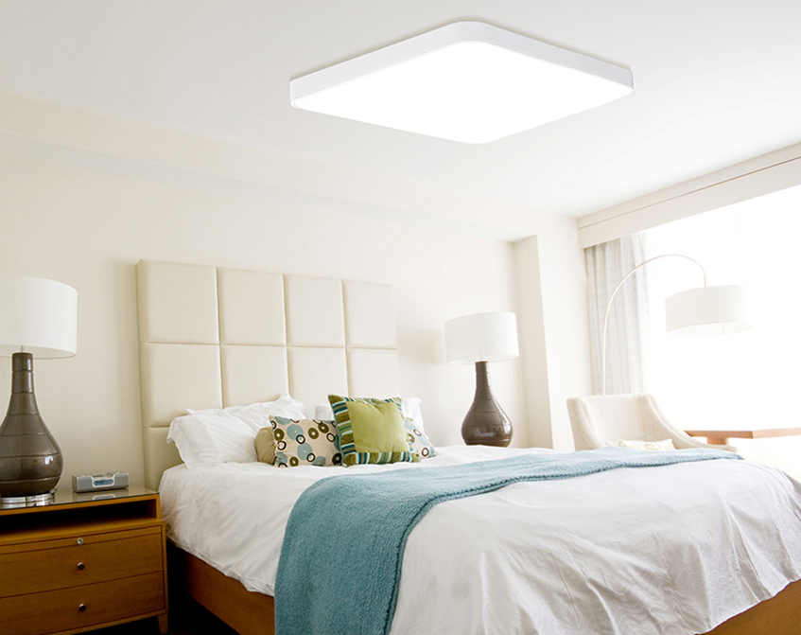
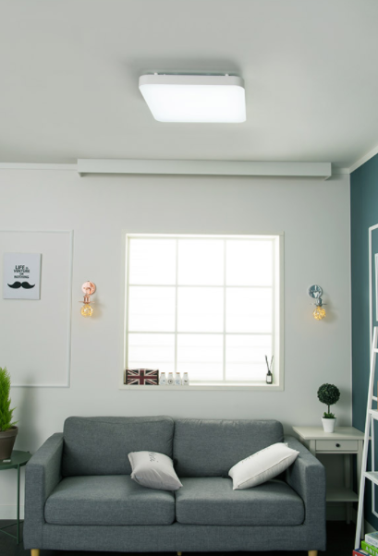
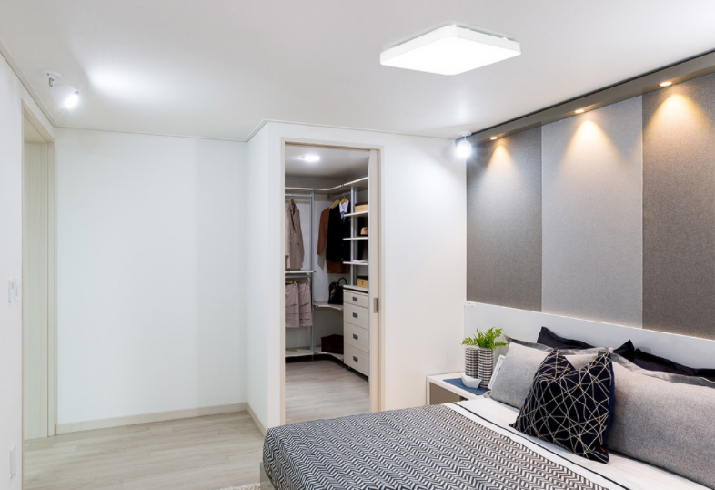
1.LED Living Room Light
Product Feature
Stable quality
No LGP, No yellowing
Cheaper than flat panel
Bright, uniform and soft light, no dark space
Flicker Free
500x500/50W
540x540/50W
Options: Changing 3 CCT by Switch
3000K
4000K
6500K
Mounted away from the ceiling
Mounted close to the ceiling
Applications:
● Perfect for supermarket, bar, cafe, clothing store, living room, etc

Slide 3
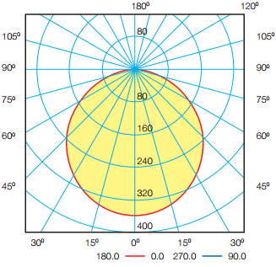
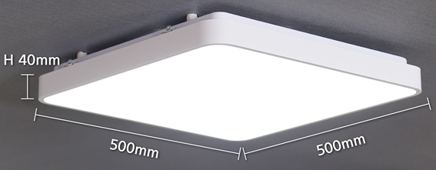
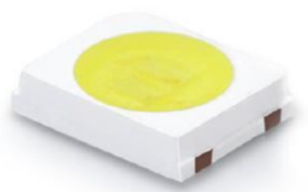
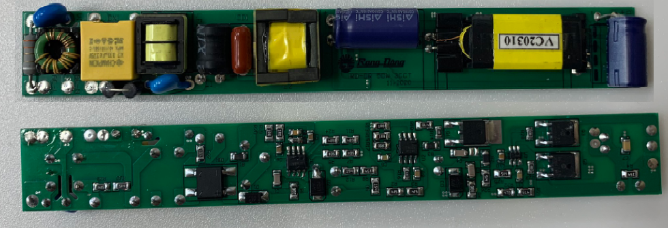
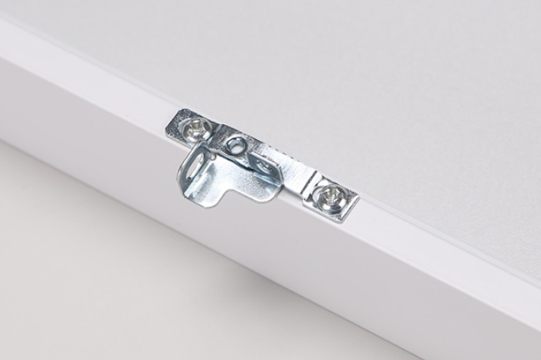
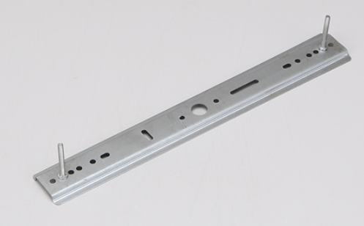
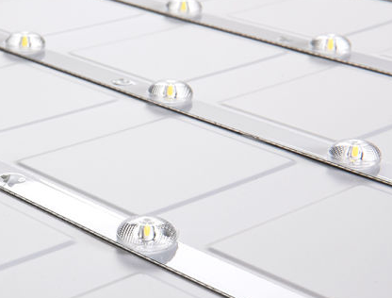
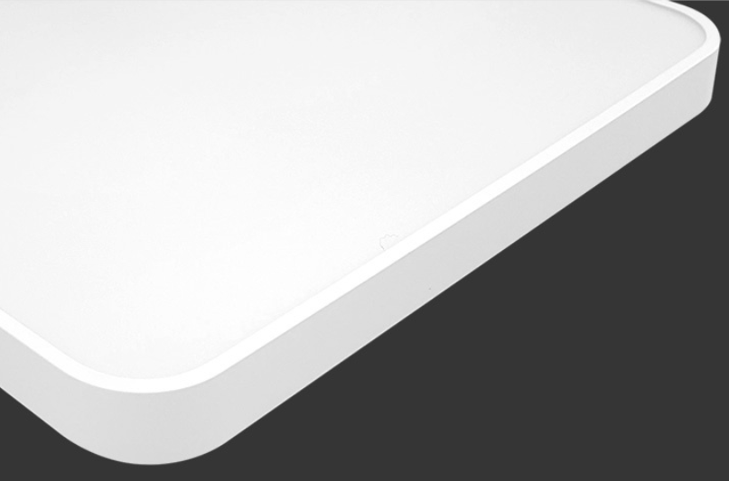
1.1 LED Living Room Light 500x500/50W
Specifications:
No. | Item | Specification
1 | Driver type | Buck, Flicker free
2 | Rated Power | 50W
3 | Rated Input Voltage | 220V/60Hz
4 | Power Factor | ≥ 0.9
5 | Luminous Flux | 4500lm
6 | Efficacy | 90lm/W
7 | Beam angle | 110°
8 | Color Rendering Index | ≥ 80
9 | Color Temperature | 5700K or changing 3CCT
10 | Operating Temperature | -10 ~ 45 ºC
11 | Frame | Aluminum 6063
12 | EMC | Pass
13 | Applied Standard | KC 60598-1/ KC 60598-2-2
14 | Size | L500×W500×H70mm
15 | Mass | 1.7kg
16 | Life time | 25,000hrs
17 | Warranty | 2years
Light Distribution
Options: Changing 3 CCT by Switch
3000K
4000K
6500K
Use Korea LED package
High quality Driver
Flicker Free
Easy to install with Lock & Bracket
Lens + PS diffuser
Uniform and soft light, no dark space
Aluminum frame
Smooth curved edges

Slide 4
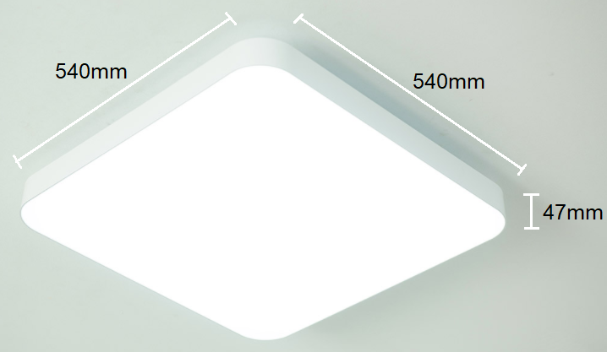
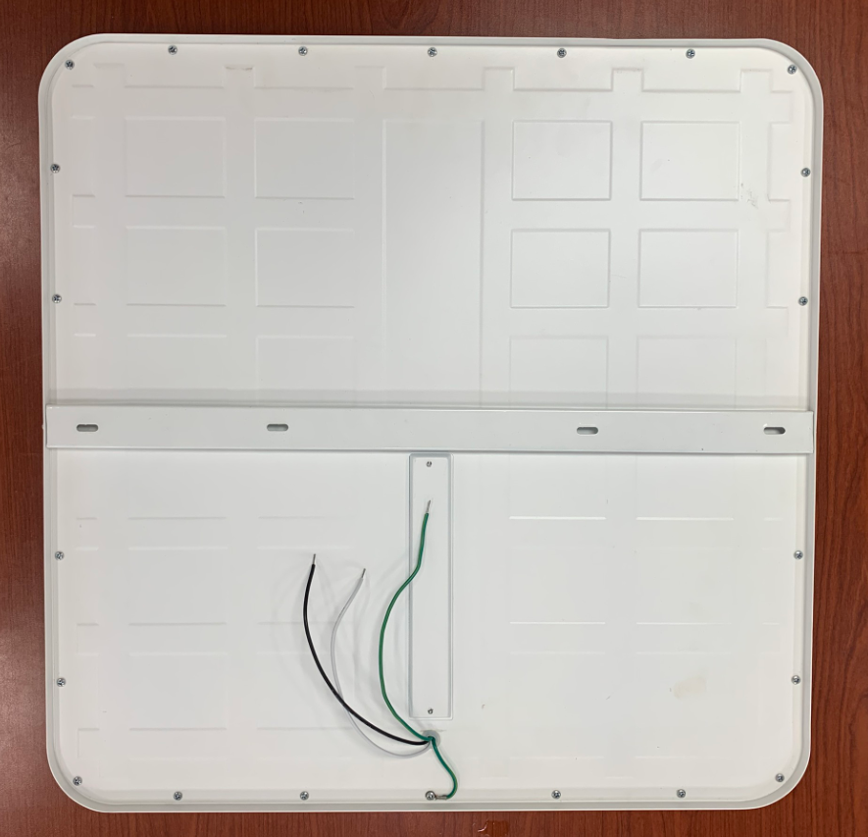
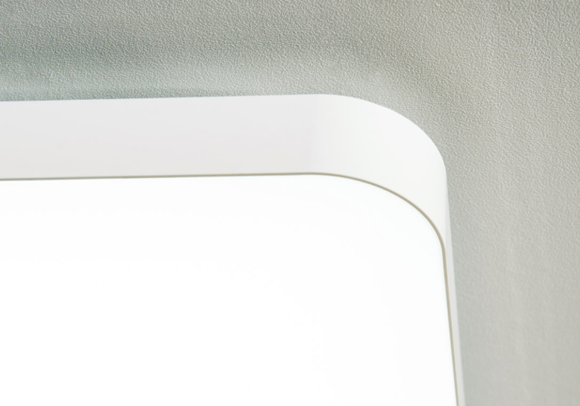
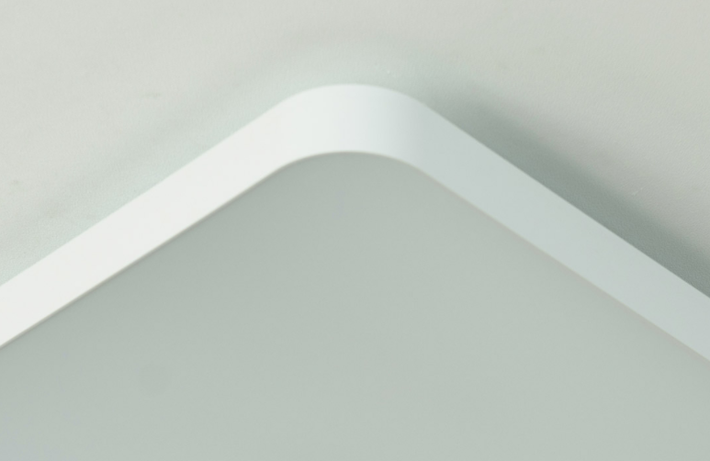
1.2 LED Living Room Light 540x540/50W
Specifications:
No. | Item | Specification
1 | Driver type | Buck, Flicker free
2 | Rated Power | 50W
3 | Rated Input Voltage | 220V/60Hz
4 | Power Factor | ≥ 0.9
5 | Luminous Flux | 4500lm
6 | Efficacy | 90 lm/W
7 | Beam angle | 110°
8 | Color Rendering Index | ≥ 80
9 | Color Temperature | 5700K or changing 3CCT
10 | Operating Temperature | -10 ~ 45 ºC
11 | Frame | Aluminum 6063
12 | EMC | Pass
13 | Applied Standard | KC 60598-1/ KC 60598-2-2
14 | Size | L540×W540×H47mm
15 | Mass | 2.3kg
16 | Lifetime | 25,000hrs
17 | Warranty | 2years
Light Distribution
Options: Changing 3 CCT by Switch
3000K
4000K
6500K
Use Korea LED package
High quality Driver
Flicker Free
Easy to install, close to the ceiling surface
Lens + PS diffuser
Uniform and soft light, no dark space
Aluminum frame
smooth curved edges

Slide 5
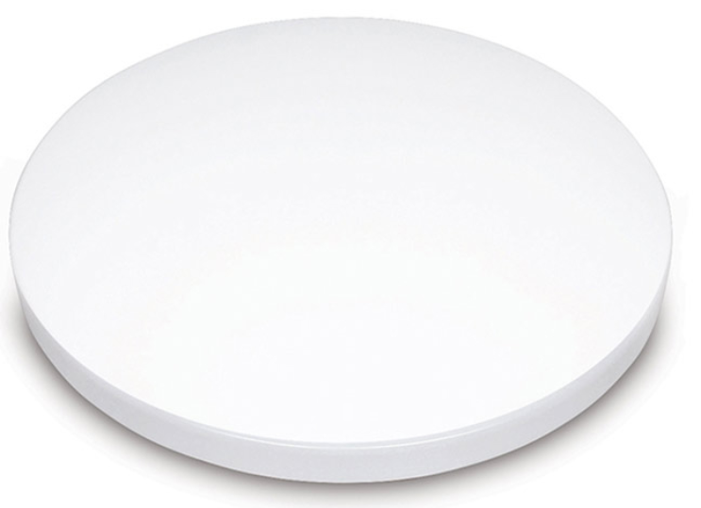
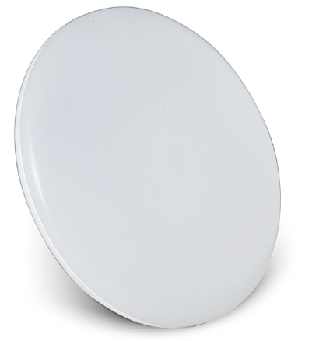
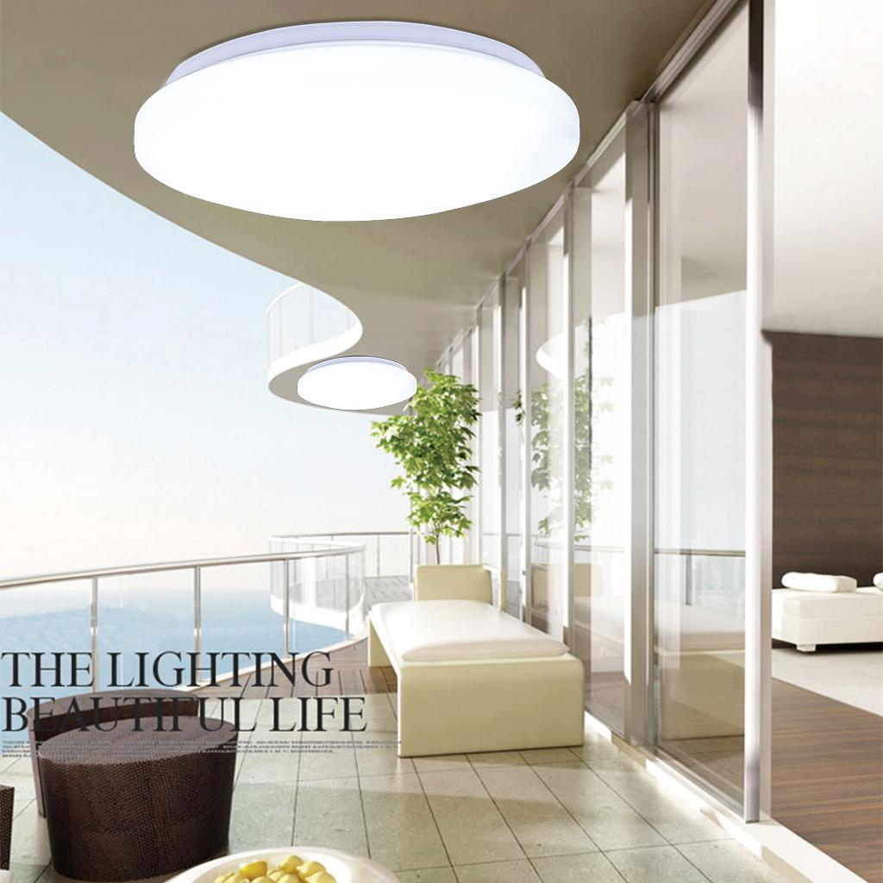
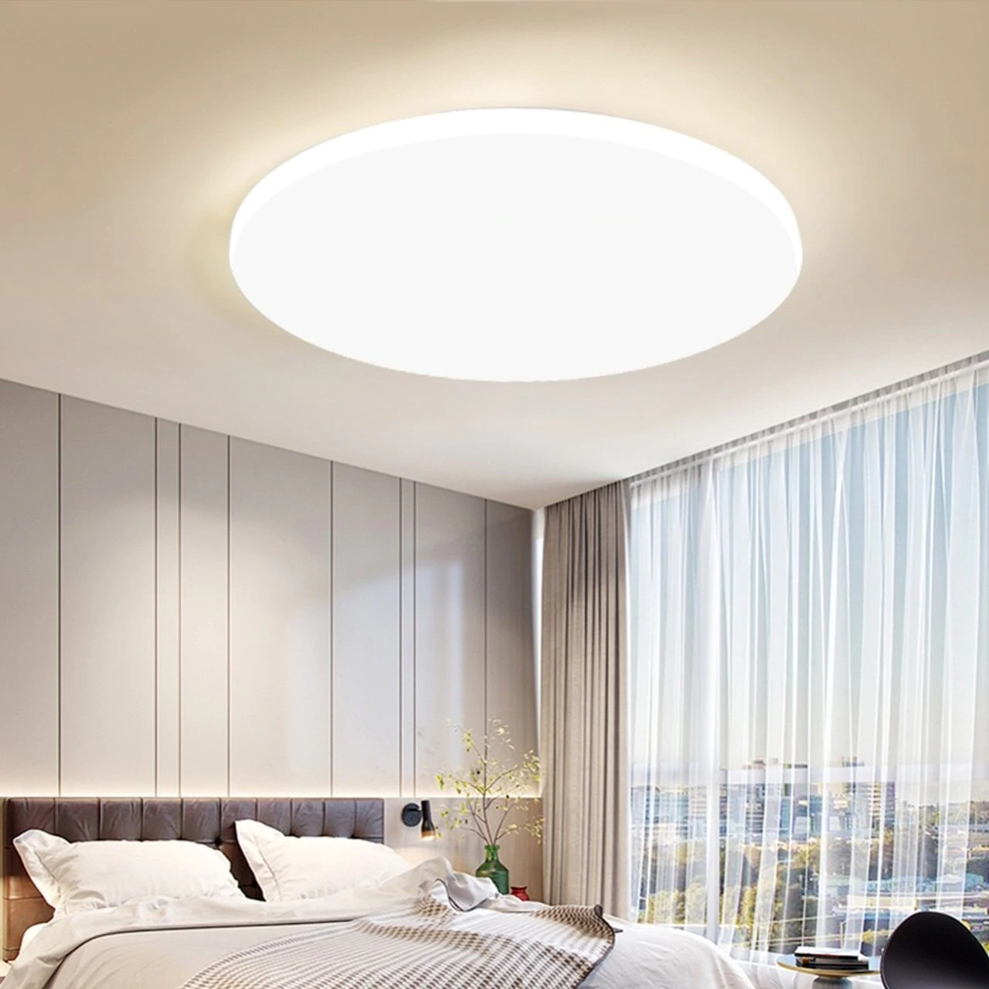
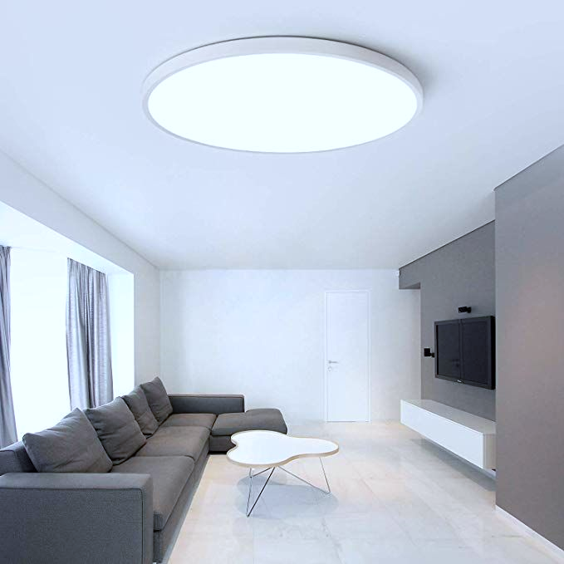
2. LED Ceiling Light
Product Feature
Stable quality
Bright, uniform and soft light, no dark space
Flicker Free
Options: Changing 3 CCT by Switch
6500K
3000K
4000K
Applications:
● Perfect for supermarket, office, store, housing, etc

Slide 6
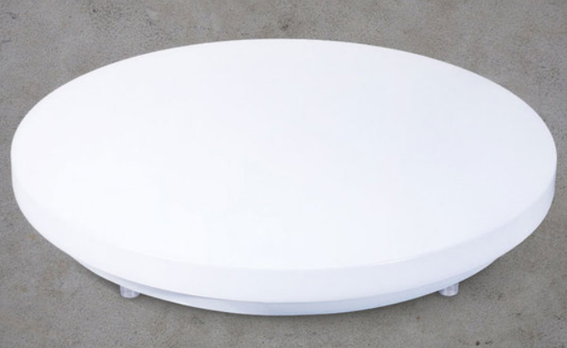
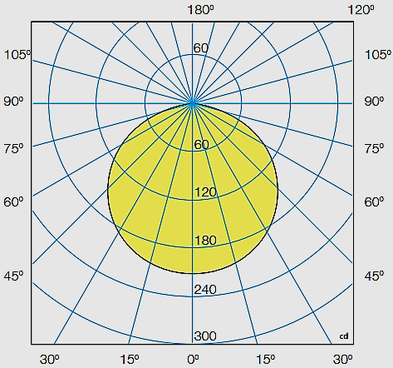
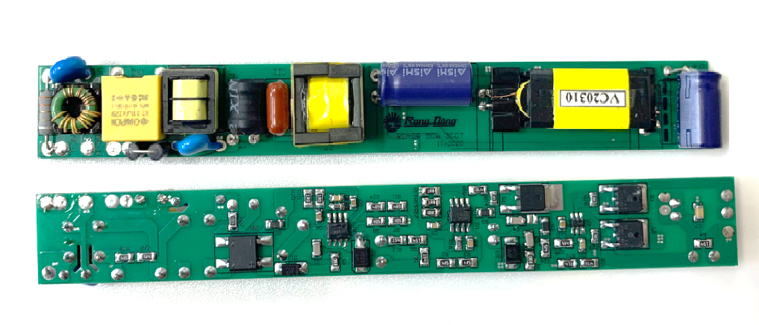
2.1. LED Ceiling Light 450/50W
Specifications:
No. | Item | Specification
1 | Driver type | Buck, Flicker free
2 | Rated Power | 50W
3 | Rated Input Voltage | 220V/60Hz
4 | Power Factor | ≥ 0.9
5 | Luminous Flux | 4500lm
6 | Efficacy | 90 lm/W
7 | Beam angle | 120°
8 | Color Rendering Index | ≥ 80
9 | Color Temperature | 5700K or changing 3CCT
10 | Operating Temperature | -10 ~ 45 ºC
11 | Back plate | Steel
12 | EMC | Pass
13 | Applied Standard | KC 60598-1/ KC 60598-2-2
14 | Size | ɸ450 × H80mm
15 | Mass | 1.0kg
16 | Lifetime | 25,000hrs
17 | Warranty | 2years
Options: Changing 3 CCT by Switch
Light Distribution
6500K
3000K
4000K
Easy to install with bracket
High quality Driver
Flicker Free
Use Korea LED package
Lens + PS diffuser
Uniform and soft light, no dark space

Slide 7
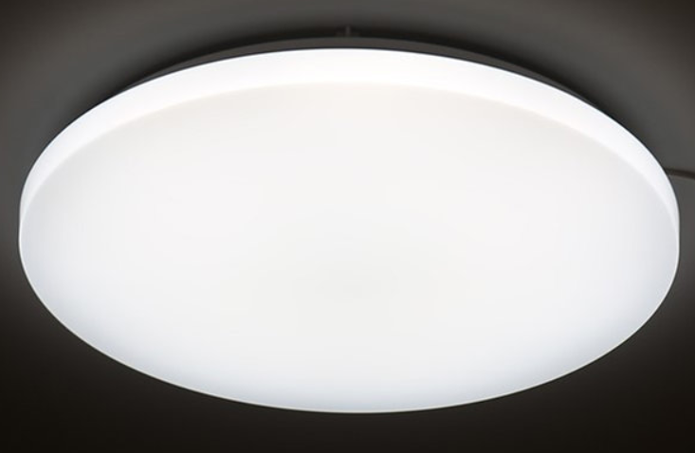
1.2. LED Ceiling Light 550/60W
Specifications:
No. | Item | Specification
1 | Driver type | Buck, Flicker free
2 | Rated Power | 60W
3 | Rated Input Voltage | 220V/60Hz
4 | Power Factor | ≥ 0.9
5 | Luminous Flux | 4500lm
6 | Efficacy | 90 lm/W
7 | Beam angle | 120°
8 | Color Rendering Index | ≥ 80
9 | Color Temperature | 5700K or changing 3CCT
10 | Operating Temperature | -10 ~ 45 ºC
11 | Back plate | Steel
12 | EMC | Pass
13 | Applied Standard | KC 60598-1/ KC 60598-2-2
14 | Size | ɸ550 × H80mm
15 | Mass | 1.8kg
16 | Lifetime | 25,000hrs
17 | Warranty | 2years
Options: Changing 3 CCT by Switch
Light Distribution
6500K
3000K
4000K
Easy to install with bracket
High quality Driver
Flicker Free
Use Korea LED package
Lens + PS diffuser
Uniform and soft light, no dark space

