Slide 1
Only presentation for Professional Customer
www.rangdong.com.vn

Slide 2
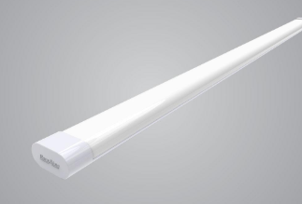
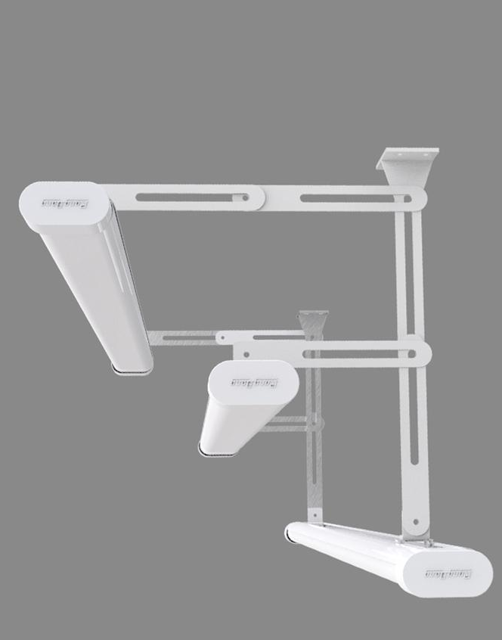
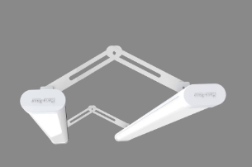
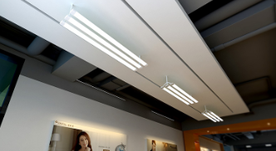
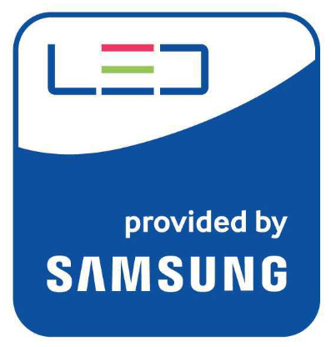
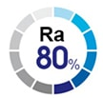
Luminaire: M36 1200/40W
Features:
Uniform spread light distribution
Eco-friendly: No mercury, less CO₂ emissions, no UV/IR
Easy to install and maintain
Lifetime: 25,000 (hrs), saving maintenance cost
Applied standard: IEC62722-2-1, IEC 60598-1
Application:
Replace fluorescent lamps
General residential lighting.
Houses, apartments, buildings, parking lots, factories, etc.
Optional:
1-CCT or 3_CCT
Specifications:
Model | Size (LxWxH_mm) | Power (W) | Voltage/ Frequency | Lumens (lm) | Efficacy (lm/W) | CRI (Ra) | CCT (K) | PF | Life time (hrs)
M36L 60/20W | 573x62x32 | 20 | 150 - 250V/ 50-60Hz | 2000 | 100 | 80 | 6500/ 3000 | 0.5 | 25,000
M36L 120/40W | 1172x62x32 | 40 | 150 - 250V/ 50-60Hz | 4000 | 100 | 80 | 6500/ 3000 | 0.5 | 25,000
M36L DM 120/40W | 1172x62x32 | 40 | 150 - 250V/ 50-60Hz | 4000-4400 | 100-110 | 80 | 3000-4000-6500 | 0.5 | 25,000

Slide 3
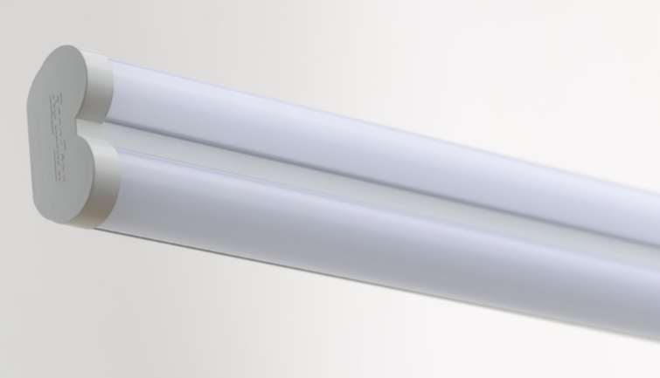
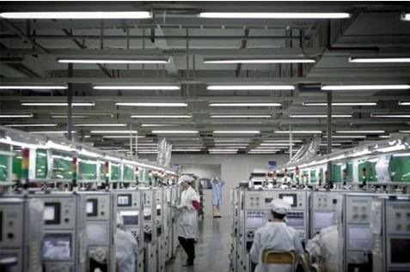
Luminaire: M38 1200/40W
Application:
Replace fluorescent lamps
General residential lighting.
Houses, apartments, buildings, parking lots, factories, etc.
Features:
Uniform spread light distribution
Eco-friendly: No mercury, less CO₂ emissions, no UV/IR
Complied with RoHS standard
Easy to install and maintain
Lifetime: 25,000 (hrs), saving maintenance cost
Applied standard: IEC62722-2-1, IEC 60598-1
Specifications:
Model | Size (LxWxH_mm) | Power (W) | Voltage/ Frequency | Lumens (lm) | Efficacy (lm/W) | CRI (Ra) | CCT (K) | PF | Life time (hrs)
M38 1200/40W | 1196x60x32 | 40 | 150 - 250V/ 50-60Hz | 5200 | 130 | 80 | 6500- 4000- 3000 | 0.5 | 25,000

Slide 4
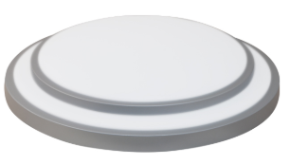
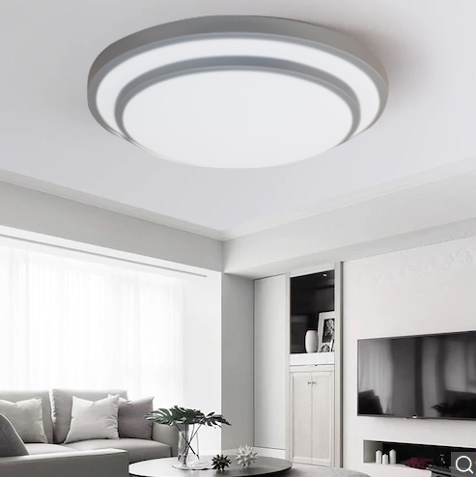
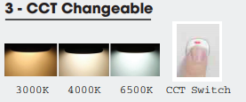
Ceiling Light Model: LN16 DM 480/40W
Features:
Eco-friendly: No mercury, less CO₂ emissions, no UV/IR
Complied with RoHS standard
Easy to install and maintain
Lifetime: 25,000 (hrs), saving maintenance cost
Applied standard: IEC 60598-1, IEC 62722-2-1, EMC
Application:
Residence, hallway, office, bar, cafe, clothing store, living room, etc
Φ
H
Specifications:
Model | Size (mm) | Power (W) | Voltage/ Frequency | Lumens (lm) | Efficacy (lm/W) | CRI (Ra) | CCT (K) | PF | Life time (hrs)
LN16 DM 480/40W | 480x86 | 40 | 150 - 250V/ 50-60Hz | 2800 | 70 | 80 | 6500- 4000- 3000 | 0.5 | 25,000

Slide 5
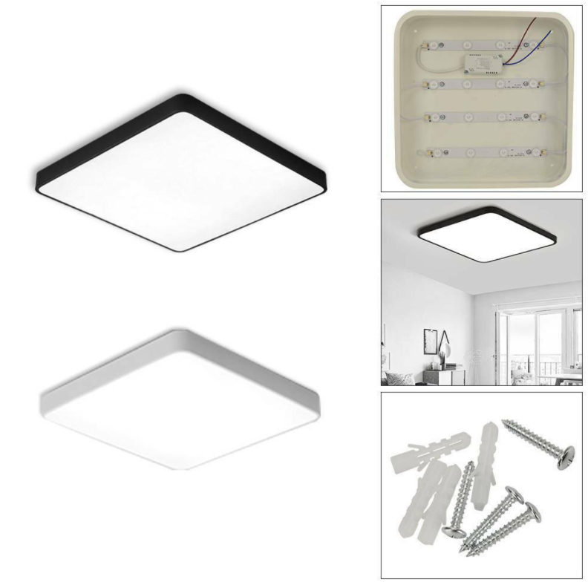
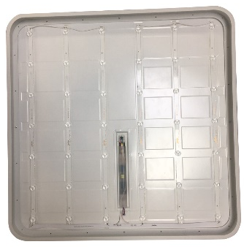
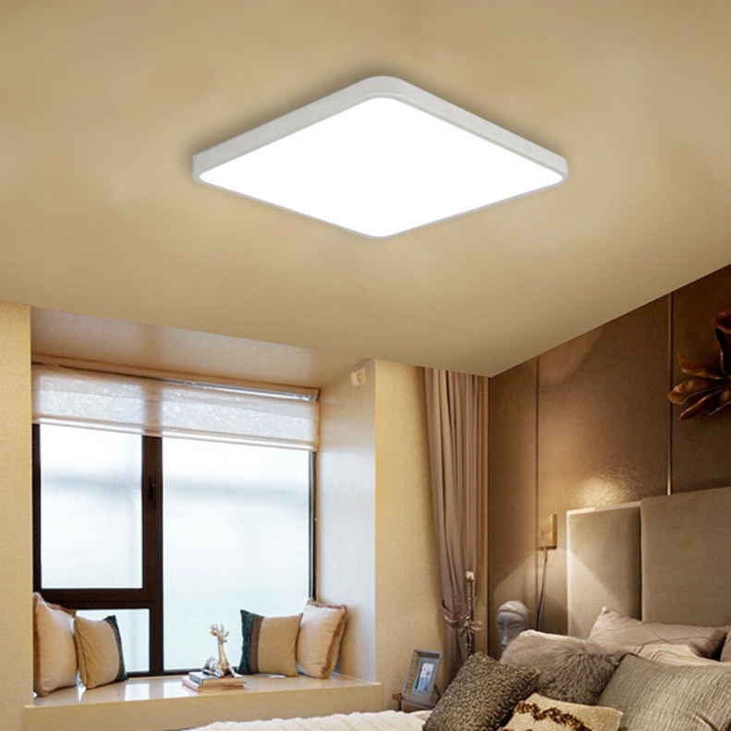
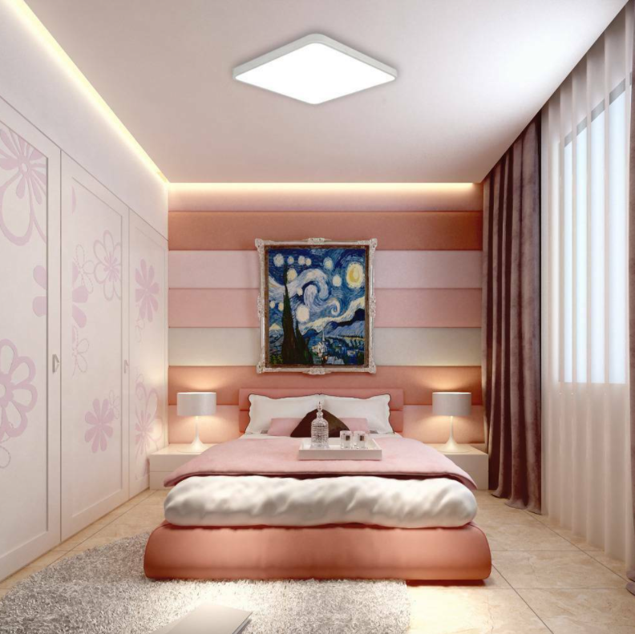
Ceiling Light Model: LN16 540x540/40W
Features:
Eco-friendly: No mercury, less CO₂ emissions, no UV/IR
Complied with RoHS standard
Easy to install and maintain
Lifetime: 25,000 (hrs), saving maintenance cost
Applied standard: IEC 60598-1, IEC 62722-2-1, EMC
Application:
Residence, hallway, office, bar, cafe, clothing store, living room, etc
Specifications:
Model | Size (mm) | Power (W) | Voltage/ Frequency | Lumens (lm) | Efficacy (lm/W) | CRI (Ra) | CCT (K) | PF | Life time (hrs)
LN16 540x540/40W | 540x540x46 | 40 | 150 - 250V/ 50-60Hz | 3600 | 90 | 80 | 6500/ 4000/ 3000 | 0.5 | 25,000

Slide 6
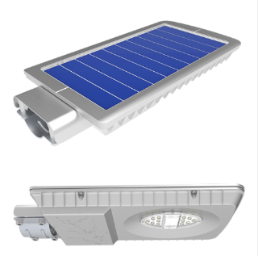
Solar Street Light
Product Description
1. Solar panel:
Power: 15W
Voltage: 5V
Poly-crystalline technology helps prolong the lifetime (appox. 25 years) and brings high reliability.
2. Battery:
Using Lithium battery that can lasts 12 years.
Battery capacity: 13 Ah
Rated voltage: 3.2V
Năng lượng dự trữ 42 Wh
3. Controller:
Charge/discharge controller protects the battery and automatically adjusts the brightness.
4. Light:
By use of high-grade LED from Cree, the light is strongly resistant to the outdoor environment
Long lifespan: 50000 hrs
Dimmable at 2 levels: 50%/ 100% brightness
IP 66
Specifications:
Model | Size (mm) | Power (W) | Lumens (lm) | CCT (K) | CRI (Ra) | IP | Lighting time (hrs) | Life span (hrs)
CSD02SL/15W | 436x204x36 | 15 | 450 | 6500/ 5000 | 70 | 66 | 12 | 50,000

Slide 7
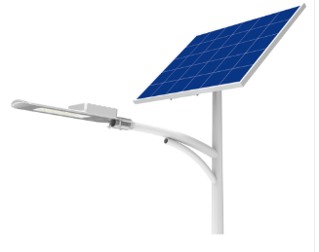
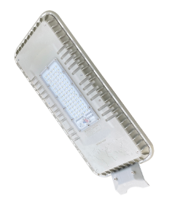
Solar Street Light
Product Description
1. Solar Panel:
Power: 65W/95W (equivalent to 30/50W luminaire)
Voltage: 5V
Poly-crystalline technology helps prolong the lifetime (appox. 25 years) and brings high reliability.
2. Battery:
Using Lithium battery that can lasts 12 years.
Battery capacity: 50 Ah
Rated voltage: 3.2V
3. Controller:
Charge/discharge controller protects the battery and automatically adjusts the brightness
4. Light:
By use of high-grade LED from Cree, the light is strongly resistant to the outdoor environment
Long : 50000hrs
Dimmabllifespane at 2 levels of brightness after 4h of operation
IP 66
CSD01SL 30W/50W
CSD01SL 70W/90W
Specifications:
Model | Size (mm) | Power (W) | Lumens (lm) | CCT (K) | CRI (Ra) | IP | Lighting time (hrs) | Life span (hrs)
CSD01SL/30W | 650x206x73 | 30 | 3200 | 6500/ 5000 | 70 | 66 | 30 | 50,000
CSD01SL/50W | 650x206x73 | 50 | 4600 | 6500/ 5000 | 70 | 66 | 30 | 50,000
CSD01SL/70W | 699x278x109 | 70 | 6800 | 6500/ 5000 | 70 | 66 | 30 | 50,000
CSD01SL/100W | 699x278x109 | 100 | 9500 | 6500/ 5000 | 70 | 66 | 30 | 50,000

Slide 8
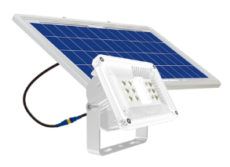
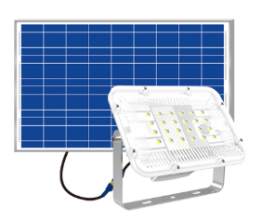
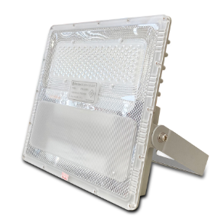
Solar Flood Lights
Product Description
1. Solar panel:
Power: 12W/36W (equivalent to 15W/40W luminaire)
Voltage: 5V
Poly-crystalline technology helps prolong the lifetime (appox. 25 years) and brings high reliability.
2. Battery :
Using Lithium battery that can lasts 12 years.
Battery capacity: 20 Ah
Rated voltage: 3.2V
Back-up energy: 64 Wh
3. Controller:
Charge/discharge controller protects the battery and automatically adjusts the brightness
4. Light:
By use of high-grade LED from Cree, the light is strongly resistant to the outdoor environment
Long lifespan: 50000 hrs.
Dimmable at 2 level: 50%/ 100% of brightness
IP 66
CP01SL/10W
CP01SL/40W
CP01SL/90W
Specifications:
Model | Size (mm) | Power (W) | Lumens (lm) | CCT (K) | CRI (Ra) | IP | Lighting time (hrs) | Life span (hrs)
CP01SL/10W | 130x90x58 | 10 | 540 | 6500/ 5000 | 70 | 66 | 12 | 50,000
CP01SL/40W | 140x200x129 | 40 | 1200 | 6500/ 5000 | 70 | 66 | 12 | 50,000
CP01SL/90W | 321x286x66 | 90 | 4600 | 6500/ 5000 | 70 | 66 | 90 | 50,000

Slide 9
THANK YOU!

