Slide 1
Only presentation for Professional Customer
Introducing LED Tube
www.rangdong.com.vn

Slide 2
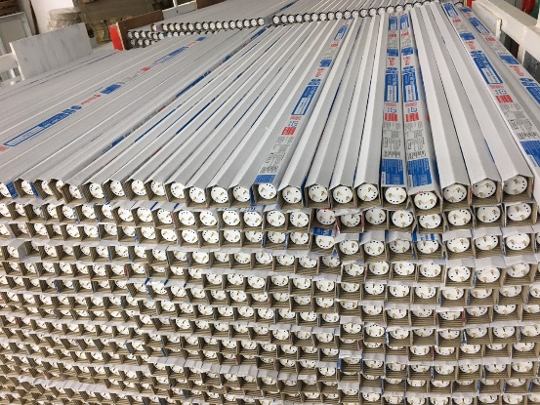
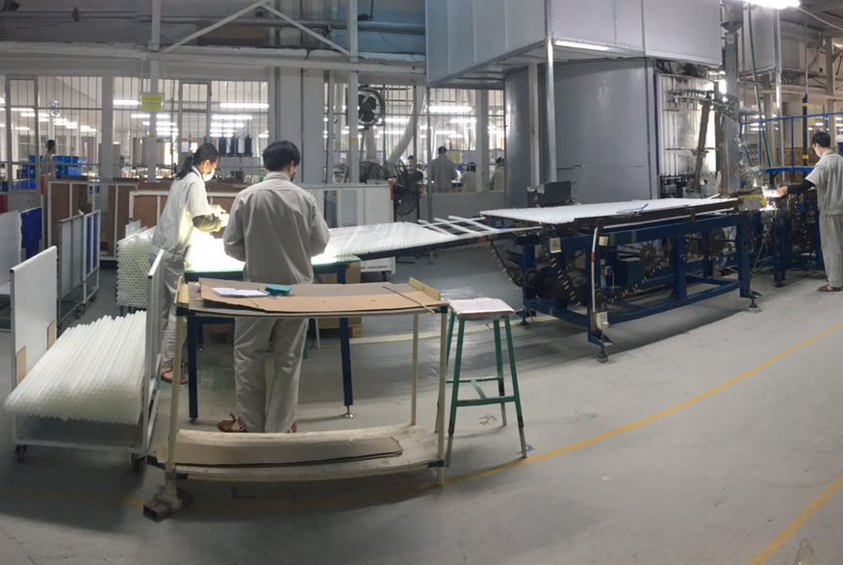
1. CAPACITY
LED TUBE PRODUCTION LINE
CAPACITY:
25 million pcs/ year
+ Glass Tube: 16 million pcs/ year
+ Al-PC Tube: 7 million pcs/ year
+ Full Plastic Tube: 2 million pcs/year
Finished products
Powder coating machine for glass tubes

Slide 3
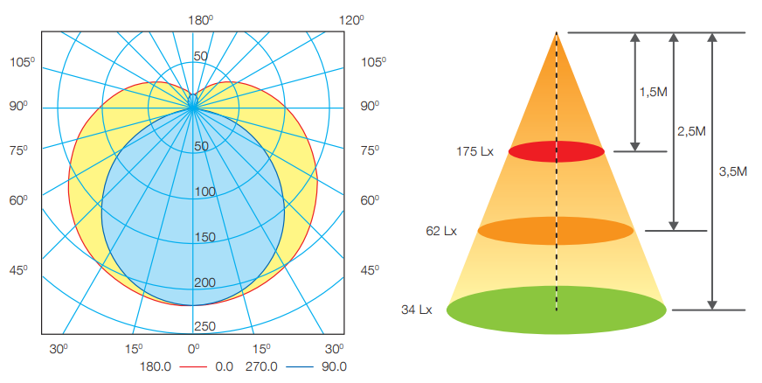
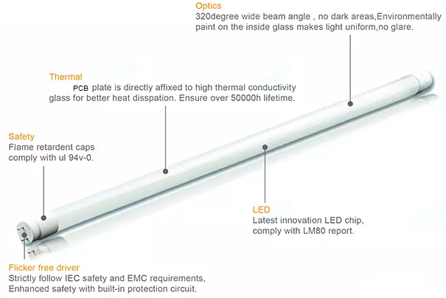
2. LED Glass Tube with powder coating
Polar Diagram Comparison
Feature
High-quality powder coating: strong color rendering, low light decay, not easy to change color
Constant current driver
Lamp head: impact resistant, high temperature resistant, flame retardant
Applied standard: IEC 62776
Specifications
Model | Power (W) | Size (D×L) mm | Voltage (V) | PF | Lumens (lm) | Efficacy (lm/W) | CCT (K) | Ra | Cap | Body Material | Life time (hrs) | FOB Haiphong port, Vietnam (USD)
 |  |  |  |  |  |  |  |  |  |  |  | MOQ 10K pcs | MOQ 20K pcs
T8 TT01 60/10W | 10 | 26×603 | 150 – 250 50/60Hz | 0.5 | 1300 | 130 | 3000/ 6500 | > 80 | PC, G13 | Glass+ Powder | 20,000
T8 TT01 120/20W | 20 | 26×1213 | 150 – 250 50/60Hz | 0.5 | 2600 | 130 | 3000/ 6500 | > 80 | PC, G13 | Glass+ Powder | 20,000
T8 TT01 60/10W | 10 | 26×603 | 150 – 250 50/60Hz | 0.5 | 1100 | 110 | 3000/ 6500 | > 80 | PC, G13 | Glass+ Powder | 20,000
T8 TT01 120/20W | 20 | 26×1213 | 150 – 250 50/60Hz | 0.5 | 2200 | 110 | 3000/ 6500 | > 80 | PC, G13 | Glass+ Powder | 20,000

Slide 4
3. LED Glass Tube with powder coating (EMC)
Polar Diagram Comparison
Feature
High-quality powder coating: strong color rendering, low light decay, not easy to change color
Constantly stable current driver
Lamp head: hitting resistant, high temperature resistant, flame retardant
Surge protection 1.5KV
Applied standard: IEC 62776, EMC
Specifications
Model | Power (W) | Size (D×L) mm | Voltage (V) | PF | Lumens (lm) | Efficacy (lm/W) | CCT (K) | Ra | Cap | Body Material | Life time (hrs) | FOB Haiphong port, Vietnam (USD)
 |  |  |  |  |  |  |  |  |  |  |  | MOQ 10K pcs | MOQ 20K pcs
T8 TT01 60/10W | 10 | 26×603 | 150 – 250 50/60Hz | 0.5 | 1100 | 110 | 3000/ 6500 | > 80 | PC, G13 | Glass+ Powder | 20,000
T8 TT01 120/20W | 20 | 26×1213 | 150 – 250 50/60Hz | 0.5 | 2200 | 110 | 3000/ 6500 | > 80 | PC, G13 | Glass+ Powder | 20,000

Slide 5
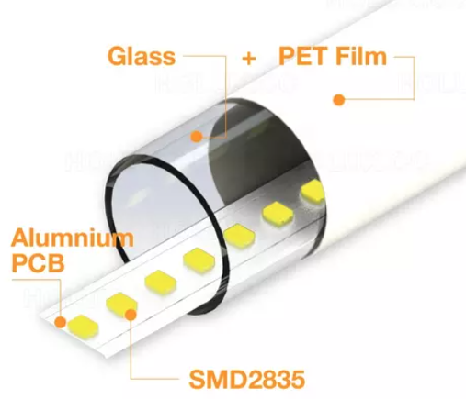
4. LED Glass Tube with PET Film
LM281BA/BA+
Feature
High-quality PET Film: strong color rendering, low light decay, not easy to change color
Constant current driver
Lamp head: impact resistant, high temperature resistant, flame retardant
Applied standard: IEC 62776
Polar Diagram Comparison
Specifications
Model | Power (W) | Size (D×L) mm | Voltage (V) | PF | Lumens (lm) | Efficacy (lm/W) | CCT (K) | Ra | Cap | Body Material | Life time (hrs) | FOB Haiphong port, Vietnam (USD)
 |  |  |  |  |  |  |  |  |  |  |  | MOQ 10K pcs | MOQ 20K pcs
T8 TT01 120/18W | 18 | 26×1213 | 150 – 250 50/60Hz | 0.5 | 2000/ 2400 | 110/ 130 | 3000- 6500 | > 80 | PC, G13 | Glass+ PET | 20,000
T8 TT01 120/20W | 20 | 26×1213 | 150 – 250 50/60Hz | 0.5 | 2200/ 2600 | 110/ 130 | 3000- 6500 | > 80 | PC, G13 | Glass+ PET | 20,000

Slide 6
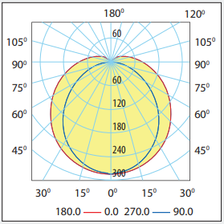
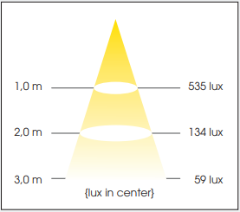
5. LED AL-PC Tube
Feature
Polar Diagram Comparison
Up to 50% less electricity consumption compared to conventional fluorescent lamps
Lowest LED heat generation through optimal heat dissipation design
Eco-friendly ( free of mercury, lower in CO2 emission , free of UV, Not infrared)
Lifetime: 25,000 hours
Applied standard: IEC 62776
Specifications
Model | Power (W) | Size (D×L)mm | Voltage (V) | PF | Lumens (lm) | Efficacy (lm/W) | CCT (K) | Ra | Base cap | Body Material | Life time (hrs) | FOB Haiphong port, Vietnam (USD)
 |  |  |  |  |  |  |  |  |  |  |  | MOQ 10K pcs | MOQ 20K pcs
T8 60/10W | 10 | 26×603 | 150 – 250 50/60Hz | 0.5 | 1100 | 110 | 3000/ 6500 | > 80 | PC, G13 | AL-PC | 25,000
T8 60/20W | 20 | 26×1213 | 150 – 250 50/60Hz | 0.5 | 2200 | 110 | 3000/ 6500 | > 80 | PC, G13 | AL-PC | 25,000

Slide 7
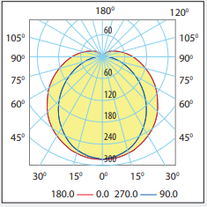
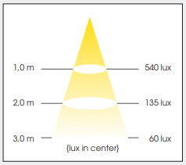
6. LED Plastic Tube
Polar Diagram Comparison
Feature
Up to 50% less electricity consumption compared to conventional fluorescent lamps
Eco-friendly (free of mercury, lower in CO2 emission , free of UV, Not infrared)
Lifetime: 20,000 hours
Applied standard: IEC 62776
Specifications
Model | Power (W) | Size (D×L) mm | Voltage (V) | PF | Lumens (lm) | Efficacy (lm/W) | CCT (K) | Ra | Cap | Body Material | Life time (hrs) | FOB Haiphong port, Vietnam (USD)
 |  |  |  |  |  |  |  |  |  |  |  | MOQ 10K pcs | MOQ 20K pcs
T8 N02 60/10W | 10 | 26×603 | 150 – 250 50/60Hz | 0.5 | 1100 | 110 | 3000/ 6500 | > 80 | PC, G13 | PC | 20,000
T8 N02 1200/20W | 20 | 26×1213 | 150 – 250 50/60Hz | 0.5 | 2200 | 110 | 3000/ 6500 | > 80 | PC, G13 | PC | 20,000

Slide 8
THANK YOU!
Contact us:
Email: export@rangdong.com.vn
thanh.nguyen@rangdong.com.vn
Mobile: (+84) 904 380 868

