Slide 1
Only presentation for Professional Customer
Desk Lamp with USB charging port
www.rangdong.com.vn

Slide 2
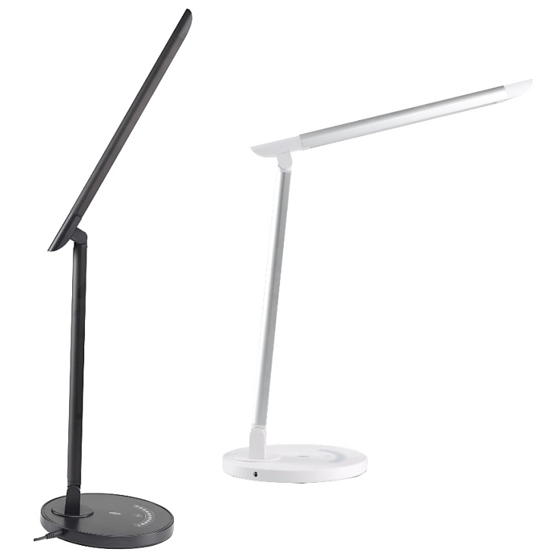
Desk Lamp with USB charging port
Description
Wonderfully Gentle on the Eyes: Shines a flicker-free light that brightens your space without harming your eyes; ideal for reading, working or studying
Endless Lighting Possibilities: Create the perfect ambience with our LED desk lamp’s unique combination of 5 color modes & 7 brightness levels
Functional USB charging port: Don’t sacrifice charging for lighting - built-in USB port keeps your phone at a full charge & within reach
Adjustable Design: Freedom to cast the perfect spotlight, tilt the head up 135 degrees & swivel 90 degrees; the base tilts down to 150 degrees & swivels 45 degrees
Energy Efficient LED: Featuring outstanding environmental performance, switch your traditional desk lamp to ours to help reduce the electricity bill by up to 75%
Specification
Model | Power (W) | Voltage (V)/ Frequency (Hz) | Iluminance (lux) | CCT (K) | Dimming | CRI (Ra) | Lifetime | Dimensions (inches) | Material
TT-DL13 | 12 | 100-277 50/60 | > 660 | 3000-4000-5000-5700-6500K | 7 brightness levels | > 85 | 50,000 | 13x7.1x15.8 | Plastic & Metal
No UV or RF interference
No toxic substance like Mercury

Slide 3
Desk Lamp with USB charging port
Feature
Fully Adjustable Angle
Rotate the head left/right 90 degrees & up/down 135 degrees to cast light directly where needed.
No UV or RF interference
No toxic substance like Mercury

Slide 4
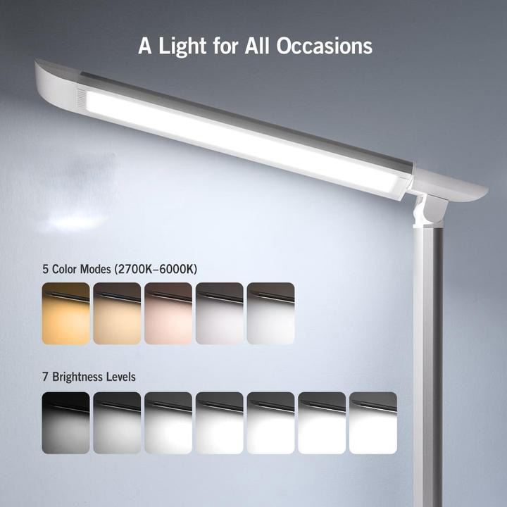
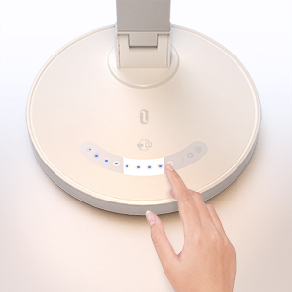
Desk Lamp with USB charging port
Feature
Built-In Touch Controls
Lightly slide your fingers along the touch pad to set the brightness level and the lighting mode.
Touch sensor is integrated to adjust the brightness at 7 levels
5 light colors changeable
High CRI (≥ 85 Ra) to bring out the truest light, enhance the color recognition of the objects.
High illumination (≥ 650 lux), even light distribution to protect the eyes and prevent short-sightedness
Flicker-free
No UV or RF interference
No toxic substance like Mercury

Slide 5
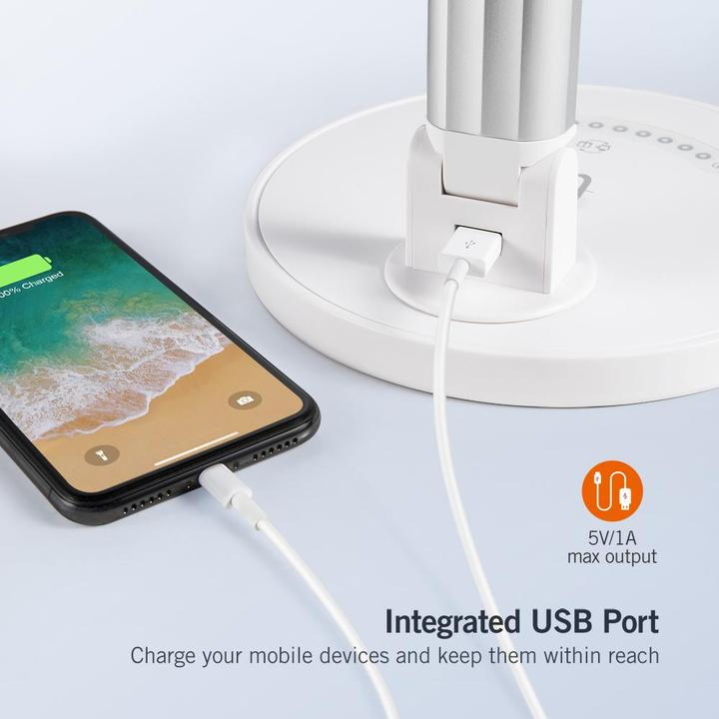
Desk Lamp with USB charging port
Feature
Handy USB Charging Port
Keep your smartphone or tablet conveniently within reach while charging.
No UV or RF interference
No toxic substance like Mercury

Slide 6
Desk Lamp with USB charging port
Packing
Suitcase gift box with handle
No UV or RF interference
No toxic substance like Mercury

Slide 7
THANK YOU!

