Slide 1
BEST OFFER New vacuum flask
Air pot - 2021

Slide 2
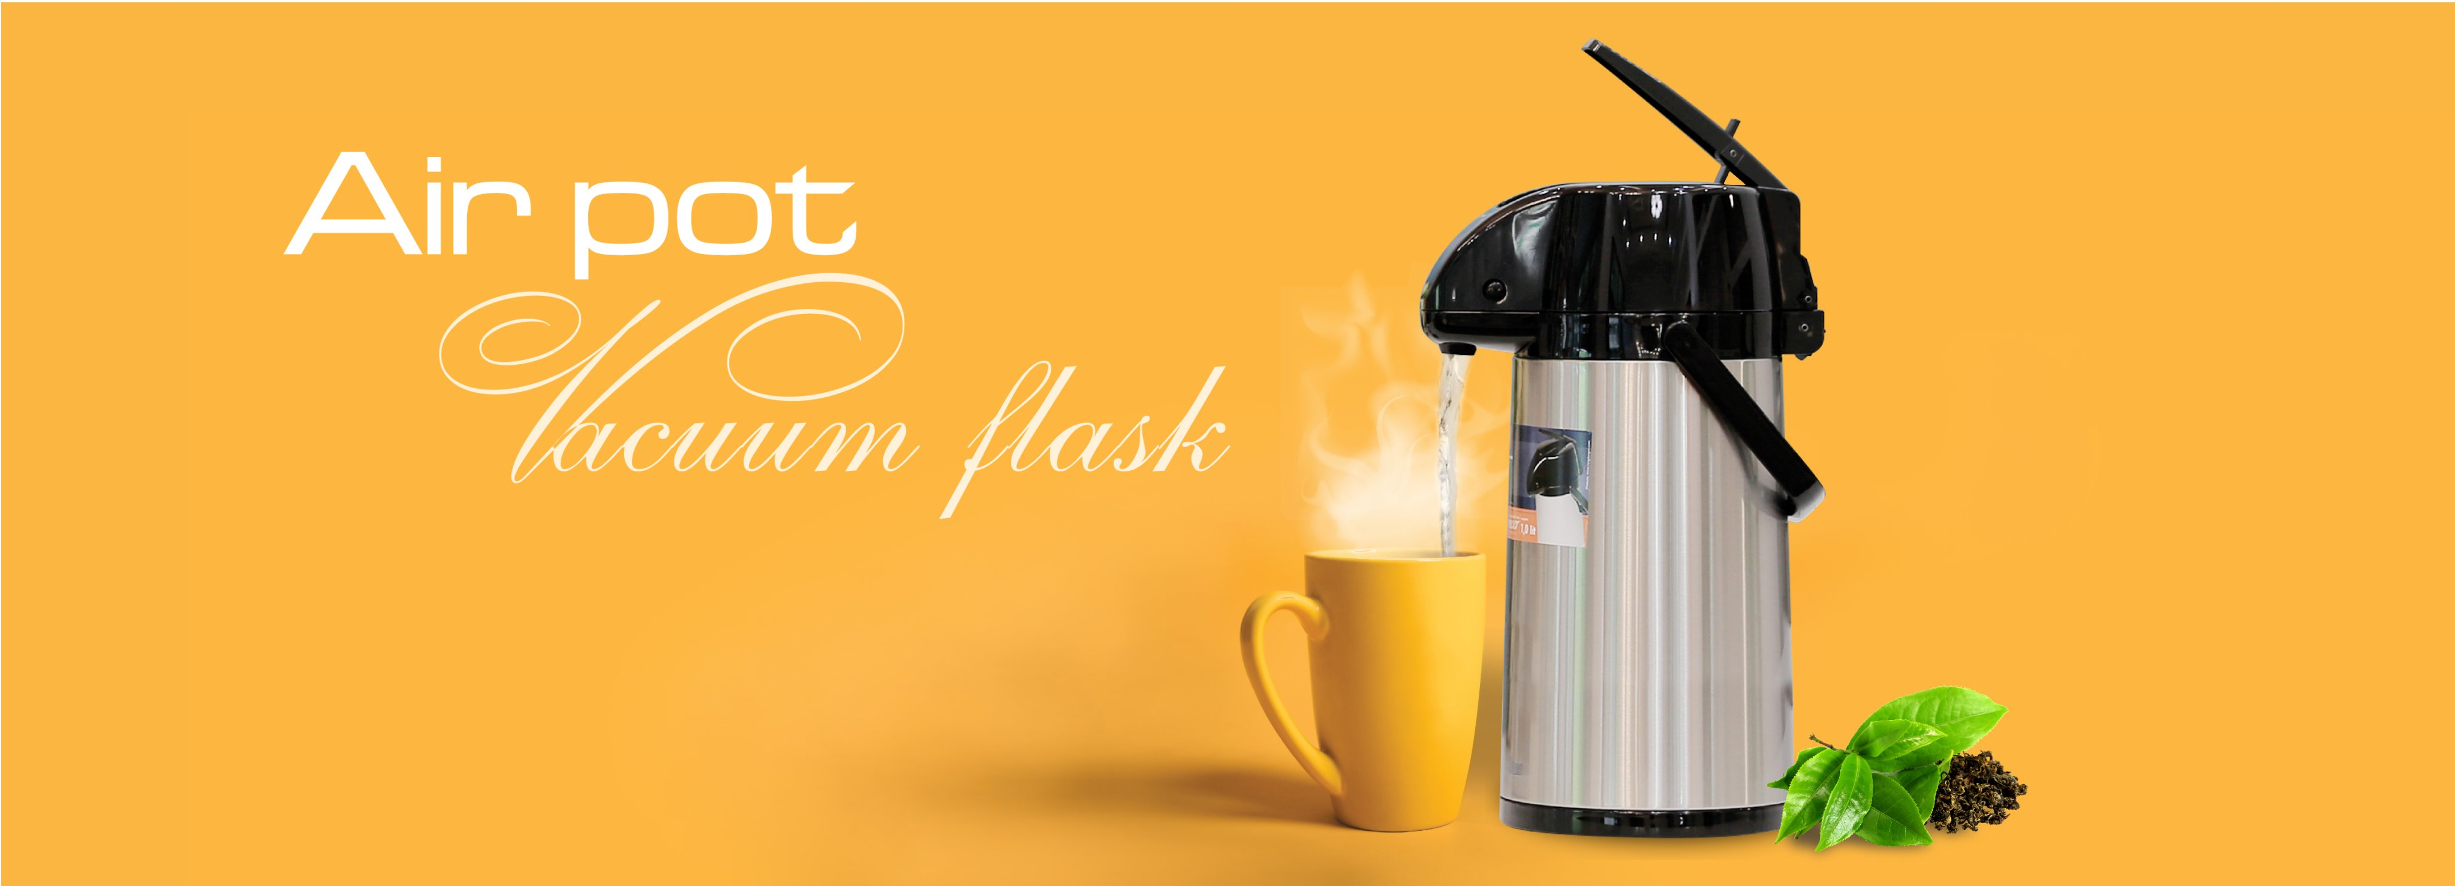

Slide 3
Ideal for enjoying hot or cold beverages Perfect companion for picnic or any outside event Suitable for living rooms, meeting rooms, hotels, restaurants and offices, etc.
New vacuum flask
Air pot

Slide 4
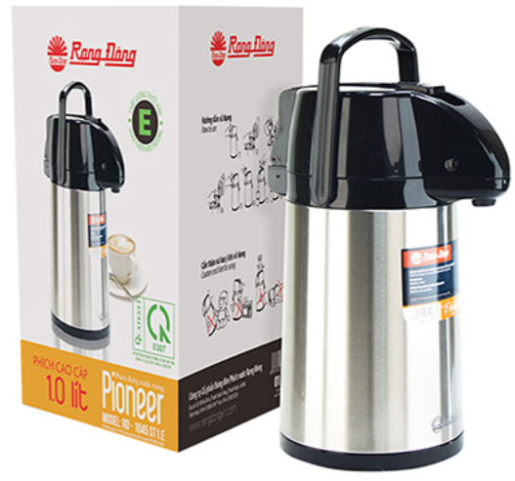
NEW design MODEL RD 1045 ST1.E-1L RD 1945 ST1.E-1.9L RD 2545 ST1.E-2.5L => UNIQUE PUMP => Swivel base => Removal pump head => easy to use => easy filling & cleaning

Slide 5
BEST OFFER
MODEL | Capacity | Price (USD/pc) (FOB- HAIPHONG PORT, VIETNAM-INCOTERMS 2020)
 |  | MOQ 1 x 40HC | MOQ 2 x 40HC | MOQ 3 x 40HC
RD 1045 ST1.E | 1 liter (~33.8 us fl.oz.) | 5.9 | 5.7 | 5.5
RD 1945 ST1.E | 1.9 liters (~67.6 us fl.oz.) | 6.2 | 6.0 | 5.8
RD 2545 ST1.E | 2.5 liters (~84.5 us fl.oz.) | 6.4 | 6.2 | 6.0
Packing: Rang Dong’s export standard (by carton)
Payment terms:
+ By T/T (deposit 30% and the balance before loading the goods into the container)
+ Or by Irrevocable L/C at sight
Validity: March 30, 2021.

Slide 6
RD 1045 ST1.E -1L
Capacity. | 1 liter (~33.8 us fl.oz.)
Heat retention | ≥78 ˚C after 6h.
Material. | Stainless Steel body, Glass refill
Gasket. | Silicone
Size (ØxH). | (152x296) mm
Gross weight. | 8.4 kgs
Dimension of carton box (LxWxH). | (515x348x352) mm
Quantity / carton box. | 6 pcs
Quantity cont 20 feet DC. | 2.556 pcs
Quantity cont 40 feet HC. | 6.192 pcs
BS EN 12546-1:2000, LFGB STANDARDS

Slide 7
RD 1945 ST1.E – 1.9L
Capacity. | 1.9 liters (~67.6 us fl.oz.)
Heat retention | ≥80 ˚C after 6h.
Material. | Stainless Steel body, Glass refill
Gasket. | Silicone
Size (ØxH). | (152x365) mm
Gross weight. | 10 kgs
Dimension of carton box (L x W x H). | (515x348x415) mm
Quantity / carton box. | 6 pcs
Quantity cont 20 feet DC. | 2.130 pcs
Quantity cont 40 feet HC. | 5.130 pcs
BS EN 12546-1:2000, LFGB STANDARDS

Slide 8
RD 2545 ST1.E -2.5L
Capacity. | 2.5 liters (~84.5 us fl.oz.)
Heat retention | ≥80 ˚C after 6h.
Material. | Stainless Steel body, Glass refill
Gasket. | Silicone
Size (ØxH). | (152x408) mm
Gross weight. | 10.8 kgs
Dimension of carton box (LxWxH). | (515x348x455) mm
Quantity / carton box. | 6 pcs
Quantity cont 20 feet DC. | 2.130 pcs
Quantity cont 40 feet HC. | 4.830 pcs
BS EN 12546-1:2000, LFGB STANDARDS

Slide 9
CONTACT
Pham Duc Tuan (Mr) Team Leader / Export Department RANG DONG LIGHT SOURCE AND VACUUM FLASK JSC | 87-89 Ha Dinh Str., Thanh Xuan Dist., Hanoi, Vietnam Email: tuan.pham@rangdong.com.vn Tel +84 24 3 858 4310 / Ext. 104 Cell. +84 912 954 289 (Whatsapp/Viber/Zalo) Wechat +84 983 954 289 Skype: targetvalue Web: http://vacuumflask.rangdong.com.vn/

