Slide 1
Introducing New Products

Slide 2
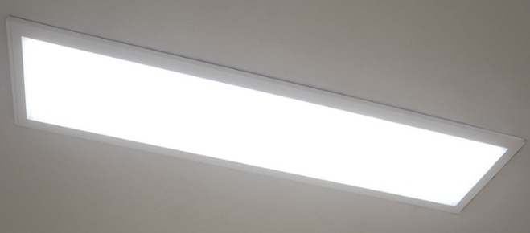
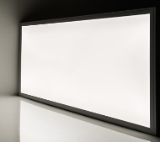
T-Bar 50W LED Panel
Specifications:
Size | Lumen | Efficacy | Weight | Illumination-equivalent
L1200xW300mm | 5500lm | 110lm/W | 4.9 kg | 2x32W FL T8
L600xW600mm | 5500lm | 110lm/W | 4.9 kg | 4x18W FL T8
Product Description:
+ Equipped with a 0-10V dimmable constant-current driver and an advanced optical diffuser, aluminum alloy frame, ensuring good lighting uniformity and high efficiency.
+ With built-in driver, it can be mounted directly to junction boxes.
+ Able to be operated within a wide range input voltage of AC 100-277V.
+ Able to control the brightness with a 0-10V dimmer or step-dimming driver.
With slim and elegant shape, this LED panel light is suitable for both residential and commercial sectors, replacing existing fluorescent troffer light fixtures.
Features:
Samsung LED chip
Lifespan: 50,000 hours
CCT: 5700K
Dimmable: Yes (0-10V, PWM, R)
Quality:
In compliance with UL/DLC regulations

Slide 3
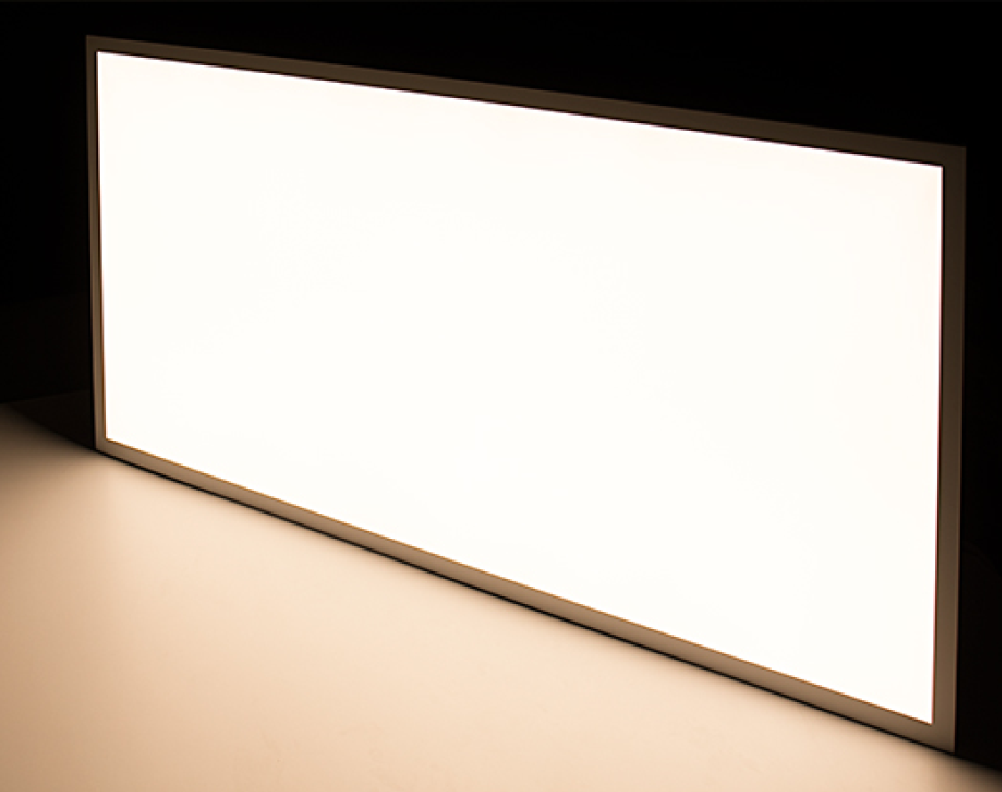
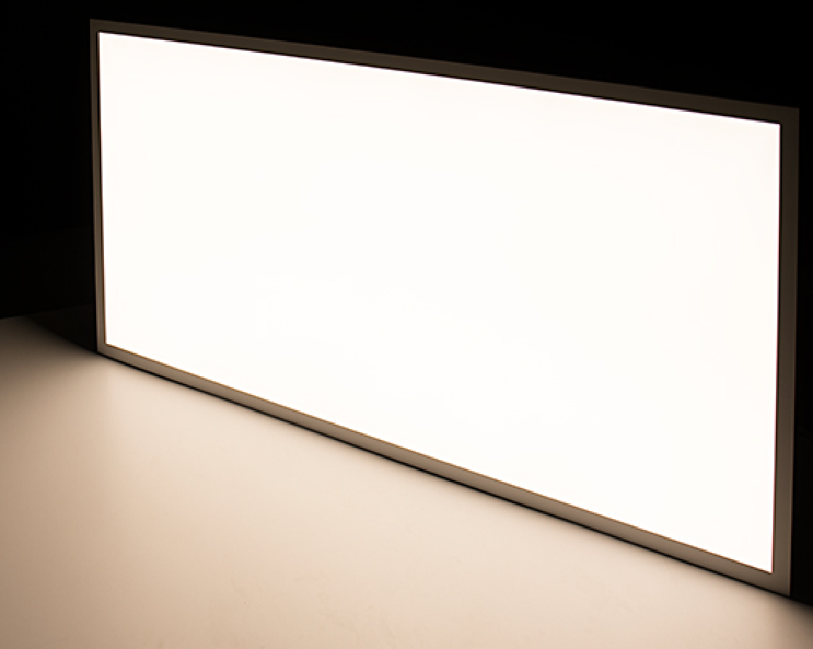
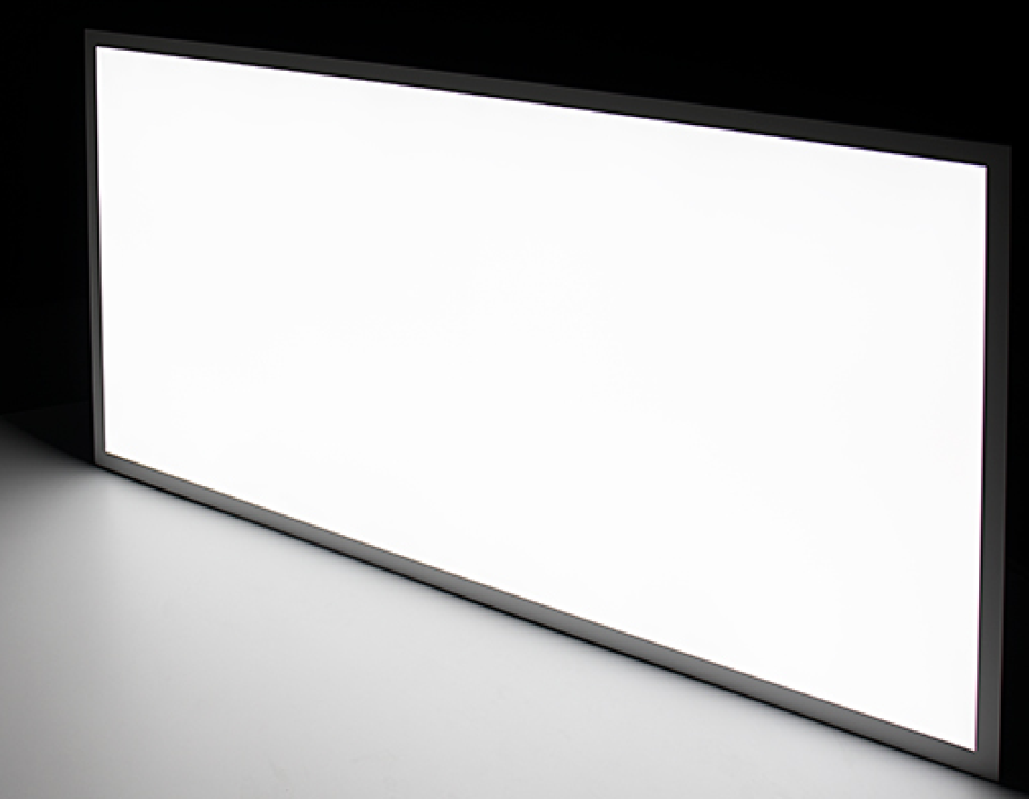
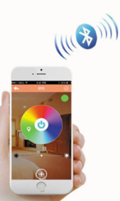
T-Bar 50W LED Panel (Tunable White)
Product Description:
+ Color temperature can be adjusted from 3000K to 5000K with the tunable white controller (to be sold separately).
+ Able to dim the light and change color temperature with just 1 simple touch on smartphone.
+ The 2 by 4 bi-color LED light is designed for suspended grid ceilings or can be used with a hanging kit.
+ With advanced technology and an optical diffuser, it delivers a smooth, flawless wall of illumination without visible bulbs or hot spots.
+ Its light emits up to 4,500 lumens of illumination—equivalent to the output of 4 18-watt fluorescent T8 tubes and operates within a wide input voltage range of 100-277 VAC, has a sturdy aluminum alloy frame with a white finish, and lasts 5 times longer than fluorescent lights.
This tunable-white LED Panel light is perfect for photography sector, continuous lighting, office, school, hospital lighting, gymnasium, basement, and other applications where it's beneficial to mimic natural daylight cycles.
Features:
Samsung LED chip
Lifespan: 50,000 hours
CCT-Tunable: 3000/ 5700/ 6500K
Dimmable and CCT-changeable by Wifi or Bluetooth
3000K
5700K
6500K
Specifications:
Size | Lumen | Efficacy | Weight | Illumination-equivalent
L1212xW300mm | 4500lm | 90lm/W | 4.9kg | 2x32W FL T8
L600xW600mm | 4500lm | 90lm/W | 4.9kg | 4x18W FL T8

Slide 4
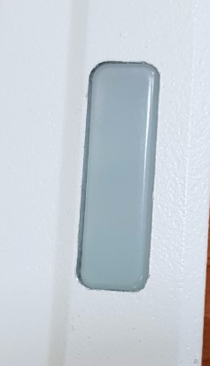
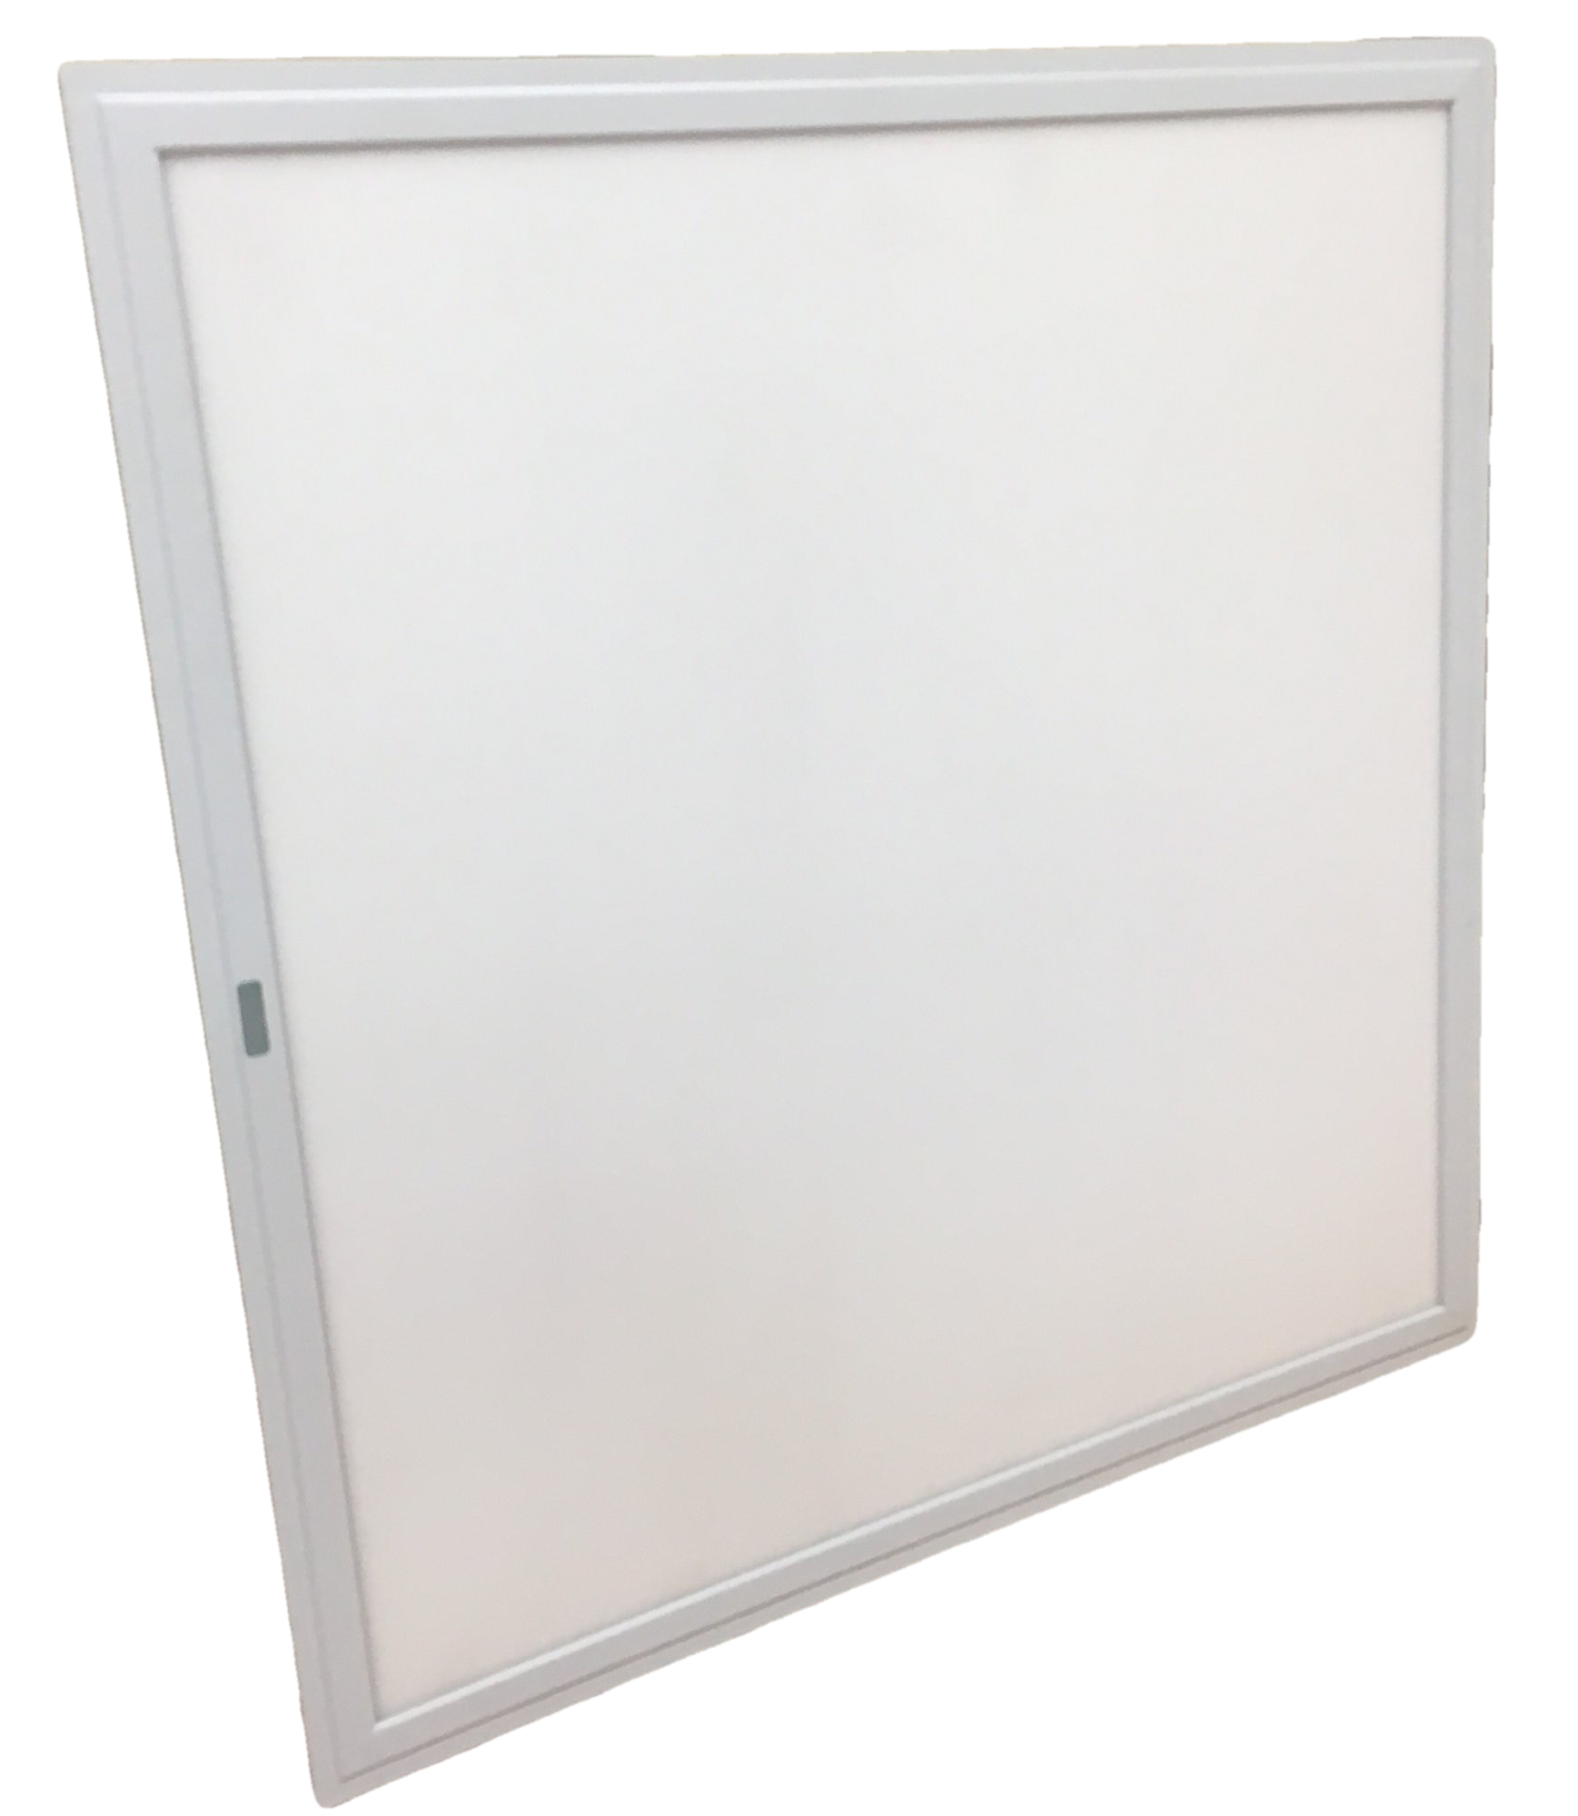
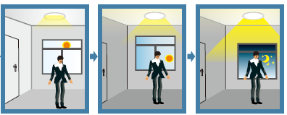
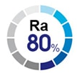
T-Bar LED Panel (Ambient Light Sensor)
Product Description:
The luminaire lights on 100% illumination or dims to maintain the preset illumination level against ambient light.
Sensor
Save at least 30%
of total energy
Specifications:
No. | Size | Wattage | Voltage | Frequency | PF | Lumen | Luminous Efficacy | CRI | CCT | Lifetime | Dimmable
1 | L600×W600mm | 50W | 220V | 60Hz | 0.9 | 5500lm | 110lm/W | 80 | 5700K | 25,000hrs | Yes
2 | L1200×W300mm | 50W | 220V | 60Hz | 0.9 | 5500lm | 110lm/W | 80 | 5700K | 25,000hrs | Yes

Slide 5
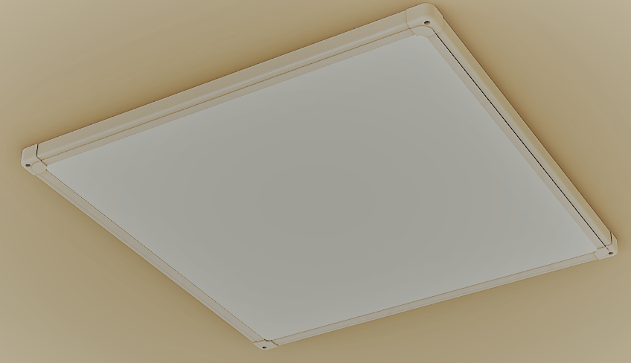
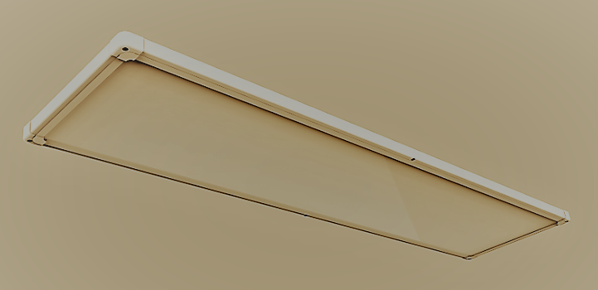
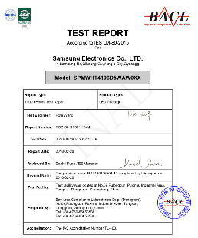
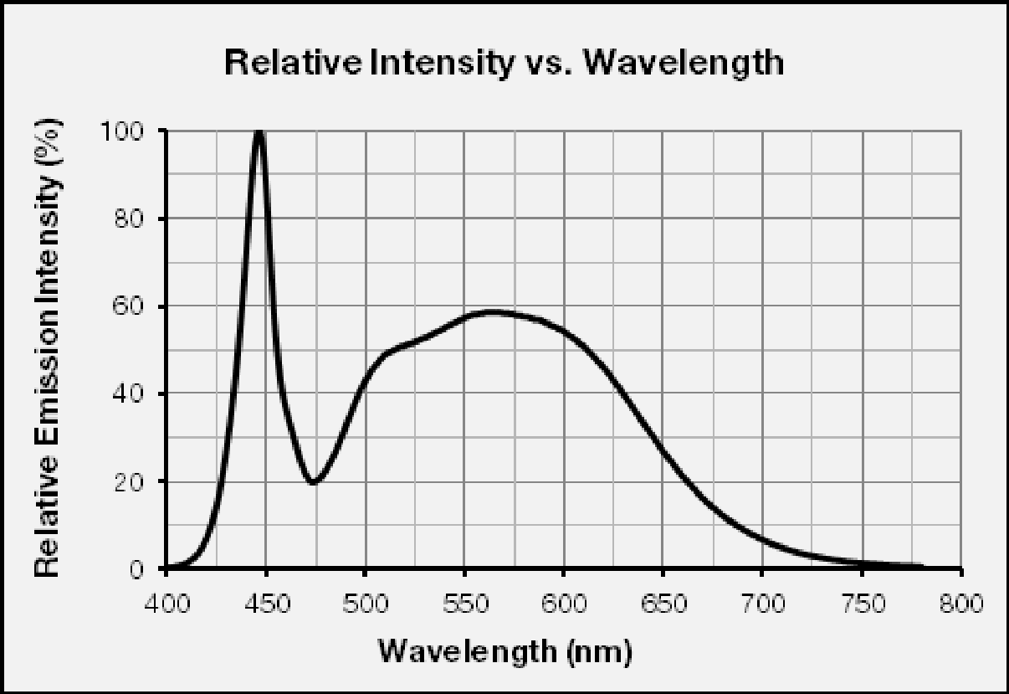
M-Bar LED Panel
Product Description
Rang Dong’s LED Panel light is equipped with Samsung 4014 luminous source, providing excellent lumen output, long-lasting stability and splendid sight.
5700K (80 CRI)
Low power consumption, saving more than 50%
of energy compared to existing fluorescent luminaire
Specifications:
No. | Size | Wattage | Voltage | Frequency | PF | Lumen | Luminous Efficacy | CRI | CCT | Lifetime
1 | L320xW320mm | 15W | 220V | 60Hz | 0.9 | 1200lm | 80lm/W | 80 | 5700K | 25,000hrs
2 | L640×W320mm | 25W | 220V | 60Hz | 0.9 | 2250lm | 90lm/W | 80 | 5700K | 25,000hrs
3 | L640xW180mm | 25W | 220V | 60Hz | 0.9 | 2250lm | 90lm/W | 80 | 5700K | 25,000hrs
4 | L950xW180mm | 30W | 220V | 60Hz | 0.9 | 2700lm | 90lm/W | 80 | 5700K | 25,000hrs
5 | L750xW320mm | 30W | 220V | 60Hz | 0.9 | 2700lm | 90lm/W | 80 | 5700K | 25,000hrs
6 | L1280xW180mm | 40W | 220V | 60Hz | 0.9 | 4400lm | 110lm/W | 80 | 5700K | 25,000hrs
7 | L520xW520mm | 40W | 220V | 60Hz | 0.9 | 4400lm | 110lm/W | 80 | 5700K | 25,000hrs
8 | L640×W640mm | 50W | 220V | 60Hz | 0.9 | 5500lm | 110lm/W | 80 | 5700K | 25,000hrs
9 | L1280×W320mm | 50W | 220V | 60Hz | 0.9 | 5500lm | 110lm/W | 80 | 5700K | 25,000hrs

Slide 6
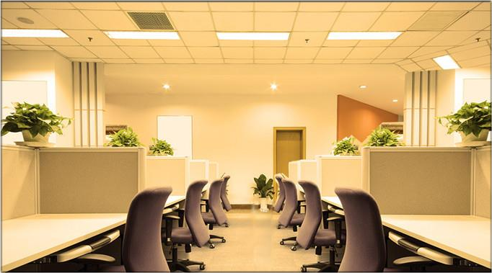
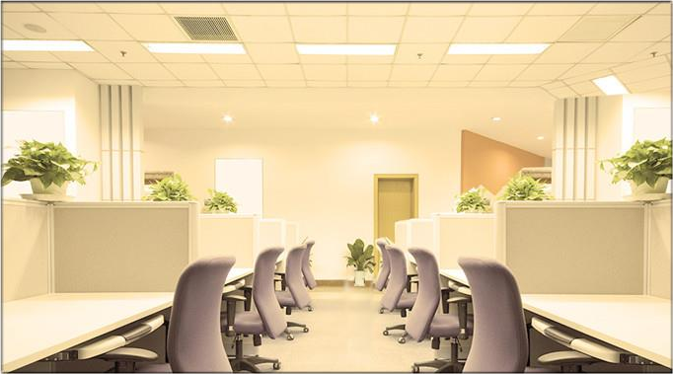
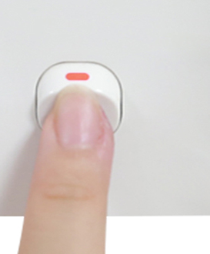
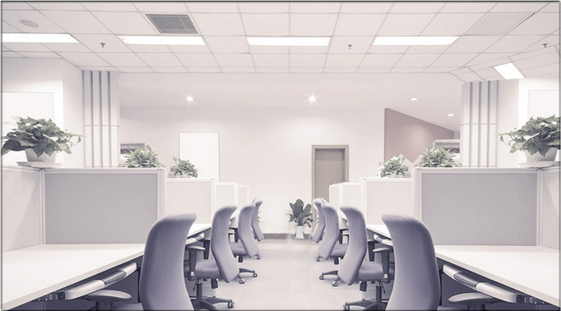
M-Bar LED Panel (CCT-changeable by Switch)
Features:
3000K
ON
OFF
4000K
CCT Switch
6500K
Specifications:
No. | Size | Wattage | Voltage | Frequency | PF | Lumen | Luminous Efficacy | CRI | CCT | Lifetime
1 | L320xW320mm | 15W | 220V | 60Hz | 0.9 | 1200lm | 80lm/W | 80 | 3000/4000/6500K | 25,000hrs
2 | L640×W320mm | 25W | 220V | 60Hz | 0.9 | 2250lm | 90lm/W | 80 | 3000/4000/6500K | 25,000hrs
3 | L640xW180mm | 25W | 220V | 60Hz | 0.9 | 2250lm | 90lm/W | 80 | 3000/4000/6500K | 25,000hrs
4 | L950xW180mm | 30W | 220V | 60Hz | 0.9 | 2700lm | 90lm/W | 80 | 3000/4000/6500K | 25,000hrs
5 | L750xW320mm | 30W | 220V | 60Hz | 0.9 | 2700lm | 90lm/W | 80 | 3000/4000/6500K | 25,000hrs
6 | L1280xW180mm | 40W | 220V | 60Hz | 0.9 | 3600lm | 90lm/W | 80 | 3000/4000/6500K | 25,000hrs
7 | L520xW520mm | 40W | 220V | 60Hz | 0.9 | 3600lm | 90lm/W | 80 | 3000/4000/6500K | 25,000hrs
8 | L640×W640mm | 50W | 220V | 60Hz | 0.9 | 4500lm | 90lm/W | 80 | 3000/4000/6500K | 25,000hrs
9 | L1280×W320mm | 50W | 220V | 60Hz | 0.9 | 4500lm | 90lm/W | 80 | 3000/4000/6500K | 25,000hrs

Slide 7
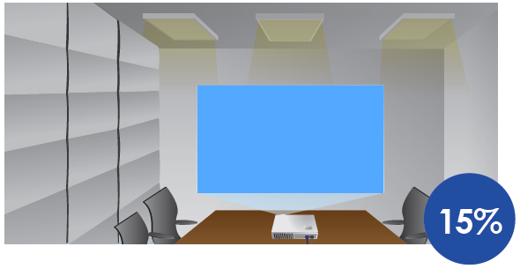
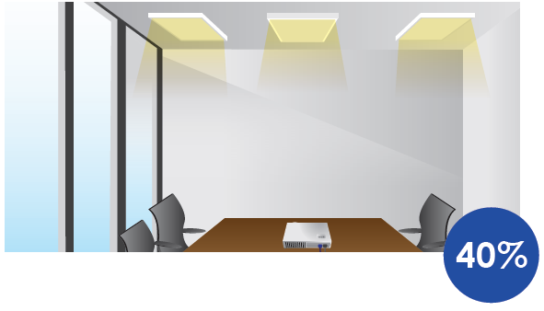
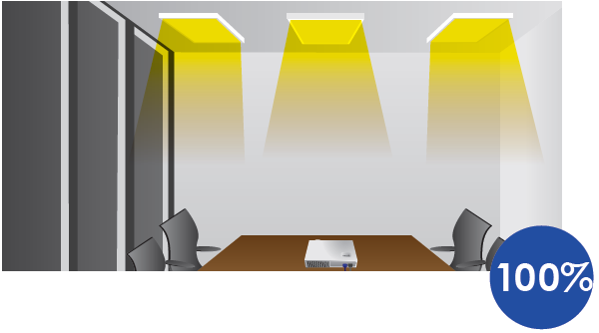
LED Panel M-Bar (3-Step Dimming by Switch)
Applications:
When using the projector in a meeting
When nature light is sufficient
When it is dark outside
ON
OFF
8%
34%
100%
CCT Switch
Save at least 30% of total energy
Specifications:
No. | Size | Wattage | Voltage | Frequency | PF | Lumens | Luminous Efficacy | CRI | CCT | Lifetime
1 | L320xW320mm | 15W | 220V | 60Hz | 0.9 | 1200lm | 80lm/W | 80 | 5700K | 25,000hrs
2 | L640xW320mm | 25W | 220V | 60Hz | 0.9 | 2250lm | 90lm/W | 80 | 5700K | 25,000hrs
3 | L640xW180mm | 25W | 220V | 60Hz | 0.9 | 2250lm | 90lm/W | 80 | 5700K | 25,000hrs
4 | L950xW180mm | 30W | 220V | 60Hz | 0.9 | 2700lm | 90lm/W | 80 | 5700K | 25,000hrs
5 | L750xW320mm | 30W | 220V | 60Hz | 0.9 | 2700lm | 90lm/W | 80 | 5700K | 25,000hrs
6 | L1280xW180mm | 40W | 220V | 60Hz | 0.9 | 3600lm | 90lm/W | 80 | 5700K | 25,000hrs
7 | L520xW520mm | 40W | 220V | 60Hz | 0.9 | 3600lm | 90lm/W | 80 | 5700K | 25,000hrs
8 | L640xW640mm | 50W | 220V | 60Hz | 0.9 | 4500lm | 90lm/W | 80 | 5700K | 25,000hrs
9 | L1280xW320mm | 50W | 220V | 60Hz | 0.9 | 4500lm | 90lm/W | 80 | 5700K | 25,000hrs

Slide 8
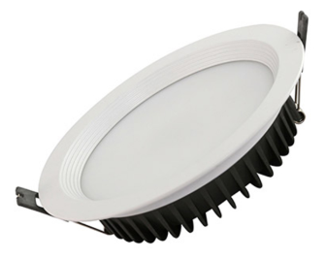
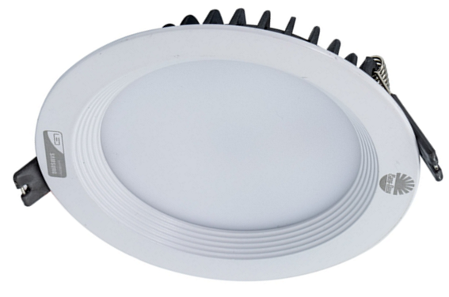
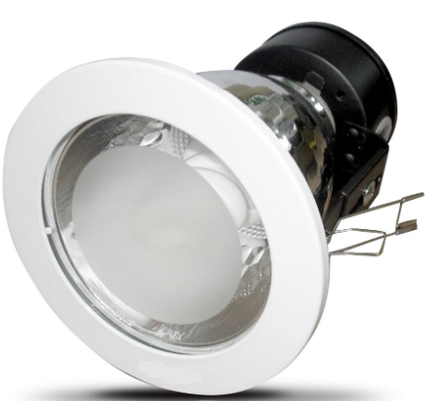
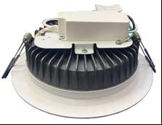
LED Downlight
Product Description
A luminaire that is well recognized in the global market for its unconventional design and outstanding performance. Its special features include ease of installation, reliable quality and high efficiency. This product can be used in many application areas including office, education, residence, hospital, etc.
Our LED Downlight was designed with the consideration of both a long lifespan and high light efficacy, while taking into account user's productivity, safety and health.
 | LED Downlight | CFC Downlight
Energy used | 15W | 30W
Energy used | 20W | 40W
Energy used | 30W | 60W
Warranty | 2 years | 1 year
50%
Specifications:
Driver type | Power (W) | Type | Size (Φ*H) mm | Voltage/ Frequency | PF | Lumen (lm) | Luminous Efficacy | CCT (K) | Housing material | Beam angle | LED chip | Certification | Lifetime (hrs) | Unit price (USD)
Linear IC | 15W | 6 inches | 180×74 | 220V/60Hz | 0.5 | 1500 | 100 | 3000/ 5700/ 6500 | ADC12 | 110° | Samsung/ SCC | EMC | 20,000
Linear IC | 20W | 6 inches | 180×74 | 220V/60Hz | 0.5 | 2000 | 100 |  | ADC12 | 110° | Samsung/ SCC | EMC | 20,000
Buck | 15W | 6 inches | 180×74 | 220V/60Hz | 0.9 | 1500 | 100 |  | ADC12 | 110° | Samsung/ SCC | EMC | 25,000
Buck | 20W | 8 inches | 242×94 | 220V/60Hz | 0.9 | 2000 | 100 |  | ADC12 | 110° | Samsung/ SCC | EMC | 25,000

Slide 9
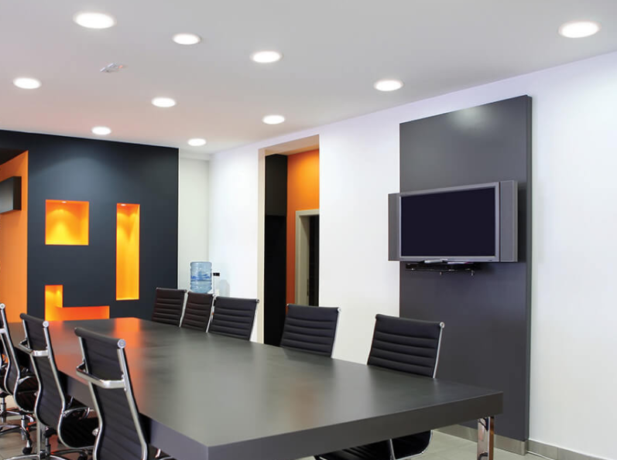
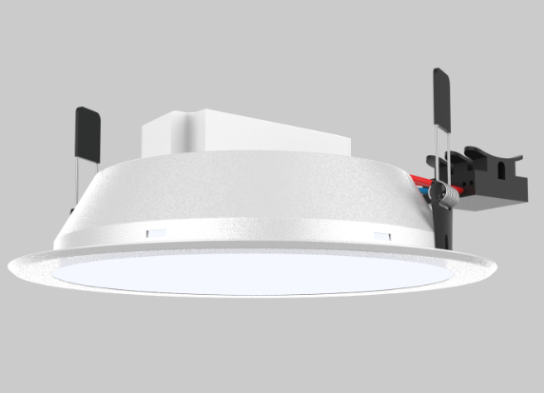
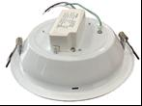
LED Downlight
 | LED Downlight | CFC Downlight
Energy used | 15W | 30W
Energy used | 20W | 40W
Warranty | 2 years | 1 year
50%
Specifications:
Driver type | Power (W) | Size (ΦxH) mm | Voltage/ Frequency | PF | Lumen (lm) | Luminous Efficacy (lm/W) | CCT (K) | Housing material | Beam angle | LED chip | Certification | Lifetime | Unit price
Linear IC | 15 | 175×35 | 220V/60Hz | 0.5 | 1500 | 100 | 3000K 5700K 6500K | Steel | 110° | Samsung/ SSC | EMC | 20,000hrs
Linear IC | 20 | 175×35 | 220V/60Hz | 0.5 | 2000 | 100 |  | Steel | 110° | Samsung/ SSC | EMC | 20,000hrs
Buck | 15 | 175×65 | 220V/60Hz | 0.9 | 1500 | 100 |  | Steel | 110° | Samsung/ SSC | KC Cert | 25,000hrs
Buck | 20 | 175×65 | 220V/60Hz | 0.9 | 2000 | 100 |  | Steel | 110° | Samsung/ SSC | KC Cert | 25,000hrs

Slide 10
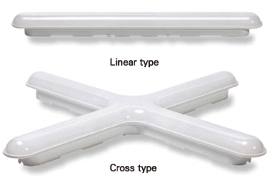
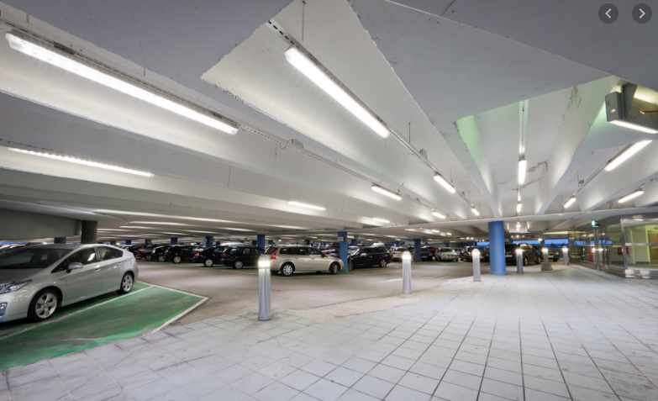
LED Linear/Cross light
Applications:
Replaces exposed / fixed fixture installed fluorescent lamp and interior lamp
Residential, parking lot, subway and commercial and industrial structures.
Features:
Low power consumption, saving more than 50% of energy compared to existing fluorescent luminaires.
Uniform spread of light.
Easy to install and maintain.
Specifications:
Driver Type | Wattage (W) | Type | Size (LxWxH) mm | Voltage/ Frequency | PF | Lumen (lm) | Luminous Efficacy (lm/W) | CCT (K) | Housing material | Beam angle | LED chip | Certification | Lifetime | Unit price (USD)
IC Linear | 30 | Linear | 600x60x50 | 220V/60Hz | 0.5 | 2300 | 76 | 3000 5700 6500 | PC | 120° | Samsung/ SSC | EMC | 30,000hrs
IC Linear | 50 | Cross | 600x600x50 | 220V/60Hz | 0.5 | 4300 | 86 |  | PC | 120° | Samsung/SSC | EMC | 20,000hrs

Slide 11
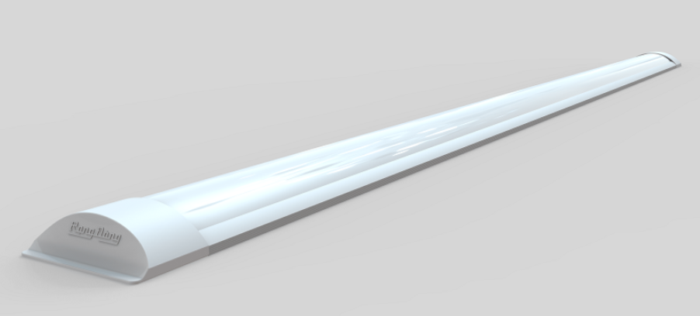
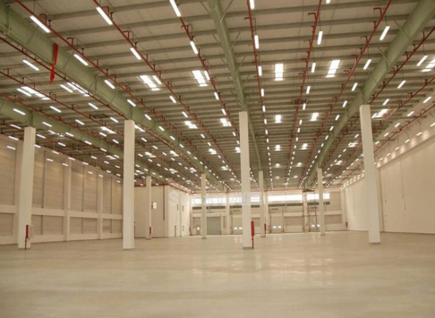
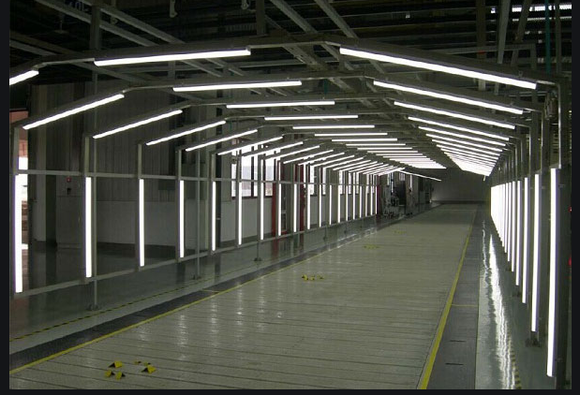
LED Linear/Cross light
Applications:
Apartment entrance, hallway lighting, indoor lighting
Parking lot, subway, commercial, industrial, etc. lighting
M16L 120/36W
Features:
Low power consumption saves more than 50% of energy compared to existing fluorescent luminaires
Various size (300/600/900/1200mm)
Slim and simple design
Uniform spread of light.
Easy to install and maintain.
Specifications:
Driver Type | Wattage (W) | Size (LxWxH) mm | Voltage/ Frequency | PF | Lumen (lm) | Luminous Efficacy (lm/W) | CCT (K) | Housing material | Beam angle | LED chip | Certification | Lifetime (hrs) | Unit price (USD)
Buck | 36 | 1200x75x24 | 220V/60Hz | 0.9 | 3400 | 95 | 3000/ 6500 | Al+PC | 120° | Samsung/ SSC | EMC | 15,000

Slide 12
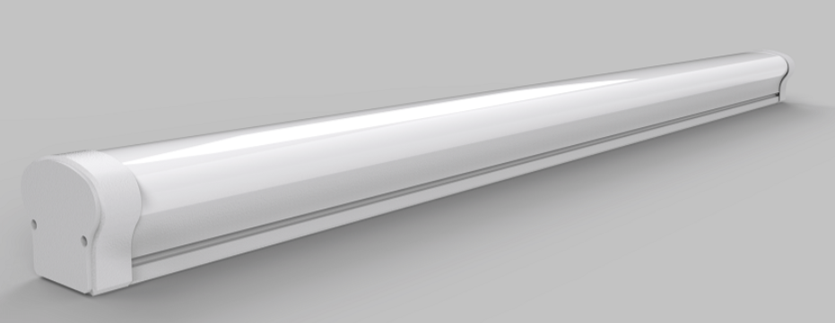
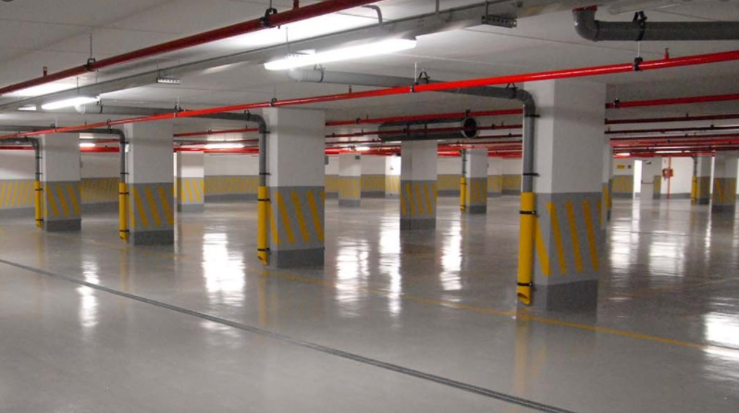
LED Linear/Cross light
Applications:
Parking lot, subway, commercial lighting
Apartment entrance, hallway lighting, indoor lighting
Warehouse, factory, gymnasium, etc. lighting
M18L 120/36W
Features:
This product with IP65 ingress protection degree suitables for dry, damp and wet locations
Low power consumption, saving more than 50% of energy compared to existing fluorescent luminaires.
Uniform spread of light.
Easy to install and maintain.
Specifications:
Driver Type | Wattage (W) | Size (LxWxH) mm | Voltage/ Frequency | PF | Lumen (lm) | Luminous Efficacy (lm/W) | CCT (K) | Housing material | Beam angle | LED chip | Certification | Lifetime (hrs) | Unit price (USD)
Buck | 36 | 1200x80x78 | 220V/60Hz | 0.5 | 3420 | 95 | 3000/ 6500 | Al+PC | 120° | Samsung/ SSC | EMC | 15,000

Slide 13
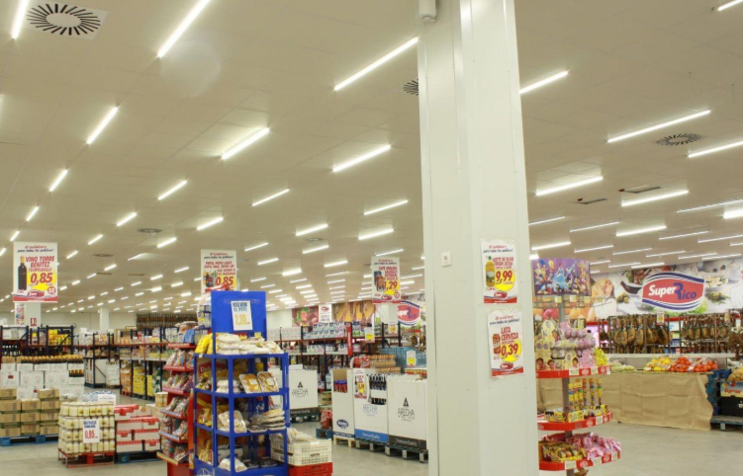
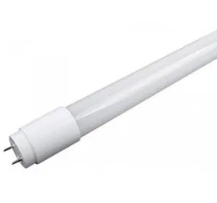
20W Hybrid LED Tube (Full Glass)
Product Description
Hybrid LED Tube is made of glass, which does not bend and is non-flammable, and powder coated to ensure good heat transfer. This Hybrid LED Tube can replace any existing T8 fluorescent tube and is compatible with AC 220V/60Hz. The tube can be installed using the existing ballast or bypass mode.
Features:
Samsung LED chip
Lifespan: 50,000 hours
CCT: 5700K
Energy efficient design
Cost-saving
Mercury and Lead Free
Installation:
Specifications:
Driver Type | Wattage (W) | Voltage/ Frequency | PF | Lumen (lm) | Luminous Efficacy (lm/W) | CCT (K) | Beam angle | LED chip | Certification | Base Cap | Lifetime (hrs) | Size (LxWxH) mm | Unit price (USD)
IC Linear | 20 | 220V/60Hz | 0.5 | 2800 - 3000 | 140-150 | 3000 6500 |  | Samsung/ SSC | CE | Plastic G13 | 20,000 | 600x60x50

Slide 14
18W Hybrid LED Tube (Full Glass)
Product Description
Hybrid LED Tube is made of glass, which does not bend and is non-flammable, and powder coated to ensure good heat transfer. This Hybrid LED Tube can replace any existing T8 fluorescent tube and is compatible with AC 220V/60Hz. The tube can be installed using the existing ballast or bypass mode.
Features:
Samsung LED chip
Lifespan: 50,000 hours
CCT: 5700K
Energy efficient design
Cost-saving
Mercury and Lead Free
Installation:
Specifications:
Driver Type | Wattage (W) | Voltage/ Frequency | PF | Lumen (lm) | Luminous Efficacy (lm/W) | CCT (K) | Beam angle | LED chip | Certification | Base Cap | Lifetime (hrs) | Size (LxWxH) mm | Unit price (USD)
IC Linear | 20 | 220V/60Hz | 0.5 | 2800 - 3000 | 140-150 | 3000 6500 |  | Samsung/ SSC | CE | Plastic G13 | 20,000 | 600x60x50

Slide 15
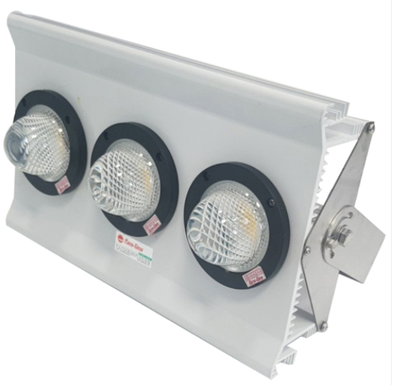
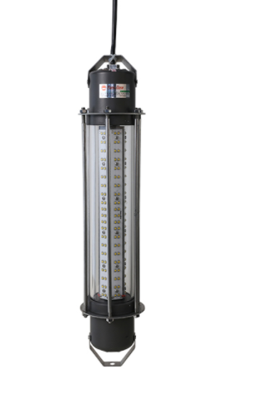
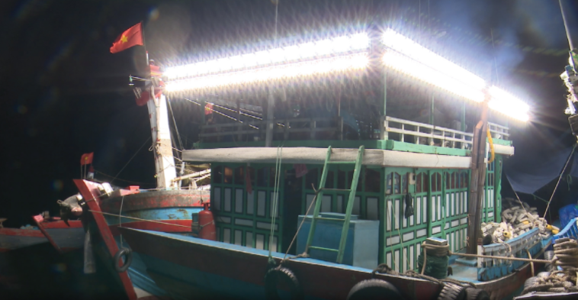
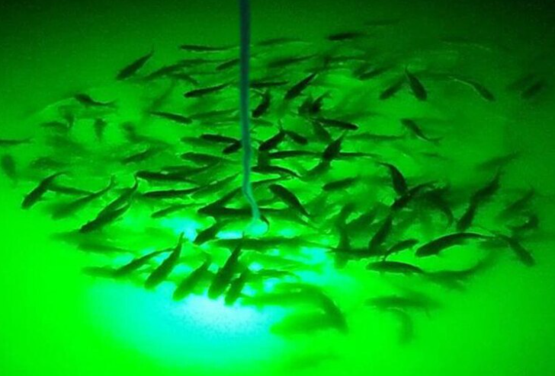
LED FISHING LIGHT
Features:
Passed EMI/EMC
Excellent Surface treatment and painting for anti-salt corrosion.
IP for anti-water, No UV
Strong for impact and violence, reducing CO₂ emission
Cost-saving
Applications:
Fishing alluring light
Under water light
Specifications:
Type | Wattage (W) | Voltage (V) | Lumen (lm) | Luminous Efficacy (lm/W) | CCT (K) | IP | Weight (kg) | Lifetime (hrs) | Material | Size (LxWxH) mm | Unit price (USD)
Fishing alluring light | 300 | 220VAC | 39000 | 130 | 4000 | 66 | 5.5 | 20,000 | AL 6063 Anodized, Inox SUS 304 | 350x220x78
Under water light | 600 | 220VAC | 48000 | 80 | 4000 | 68 | 4.0 | 20,000 | AL 6063 Strongly Anodized, PPMA, Inox SUS 304 | Φ102x450
Under water light | 600 | 220VAC | 48000 | 80 | Green | 68 | 4.0 | 20,000 | AL 6063 Strongly Anodized, PPMA, Inox SUS 304 | Φ102x450
Under water light | 200 | 220VAC | 17000 | 85 | 4000 | 68 | 3.0 | 20,000 | AL 6063 Strongly Anodized, PPMA, Inox SUS 304 | Φ102x440
Under water light | 200 | 220VAC | 17000 | 85 | Green | 68 | 3.0 | 20,000 | AL 6063 Strongly Anodized, PPMA, Inox SUS 304 | Φ102x440

Slide 16
THANK YOU!
Website: rangdong.com.vn
Telephone: (+84) 24 38 584 310 / 38 584 165
Email: export@rangdong.com.vn

